Slide 1



Making better conservation decisions
Jeffrey Hanson
jeffrey.hanson@uqconnect.edu.au
jeffrey-hanson.com

Slide 2









Acknowledgements
Adam Marques
Amanda Martin
Ana Veríssimo
Angela Brennan
Carlo Rondinini
Caitlyn Proctor
Cynthia Riginos
Emma Hudgins
Francesco Ficetola
Graeme Buchanan
Guillermo Velo-Antón
Iadine Chadès
Íñigo Martínez-Solano
Hugh Possingham
Jaimie Vincent
Jenny McCune
Jonathan Rhodes
Joseph Bennett
Josie Hughes
Lenore Fahrig
Matt Watts
Matthew Strimas-Mackey
Miguel Camacho-Sanchez
Nina Morell
Peter Arcese
Richard Fuller
Richard Pither
Richard Schuster
Silvia Carvalho
Stuart Butchart

Slide 3
Now
Biodiversity
Status quo
2000
Future

Slide 4
Now
How do we
get here?
Biodiversity
Status quo
2000
Future

Slide 5
How can we get a better conservation decision?
(1) Better algorithms
(2) Better data
(3) Better surrogates

Slide 6



Ecological surveys
Distribution maps
Priority areas
Biodiversity
2000
Future
Data
Information
Plan
Outcome
Objectives
Constraints

Slide 7
Ecological surveys
Distribution maps
Priority areas
Biodiversity
2000
Future
Data
Information
Plan
Outcome
Better
algorithms
Better
outcome
Objectives
Constraints

Slide 8
Reserve selection
Features
Notes:
- not all remaining habitat can be preserved
- achieve conservation objectives for minimal cost
- modern systematic conservation planning primarily focusses on representing species
- however, this ignores intra-specific biodiversity
8

Slide 9
Reserve selection
Planning units

Slide 10
Reserve selection
?
?
?
?
?
?

Slide 11
Reserve selection

Slide 12





Heuristic
algorithm
Meta-heuristic
algorithms
Exact
algorithms
Estimate of best quality
Quality
Different
solutions
Different
solutions
Different
solutions

Slide 13




prioritizr R package
What you value
Input to solver
Data
Mathematical
optimization
problem
Biodiversity
Land use
Economic
Solve problem
What the solution
should (or not) do
Maps
Metrics
Hanson et al. 2020 CRAN

Slide 14
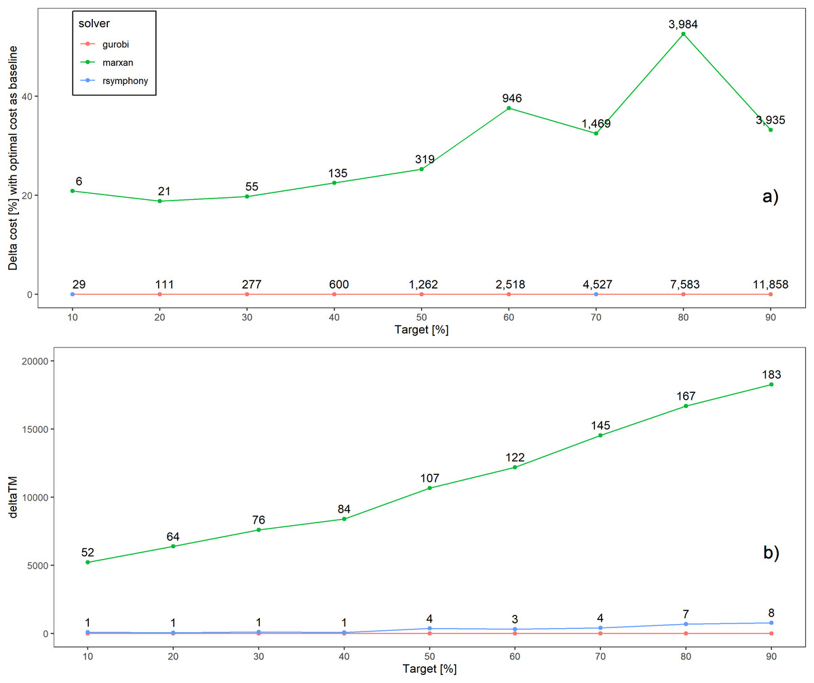
Better solutions
Schuster et al. 2020 PeerJ

Slide 15
Faster too!
183x slower
52x slower
Time difference
Schuster et al. 2020 PeerJ

Slide 16
What about other types of problems?

Slide 17
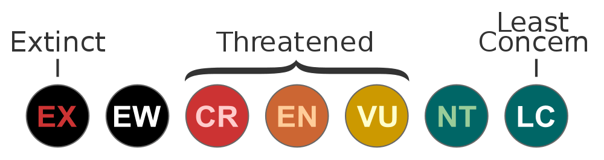







Project prioritization

Slide 18
Project prioritization

Slide 19
Project prioritization

Slide 20
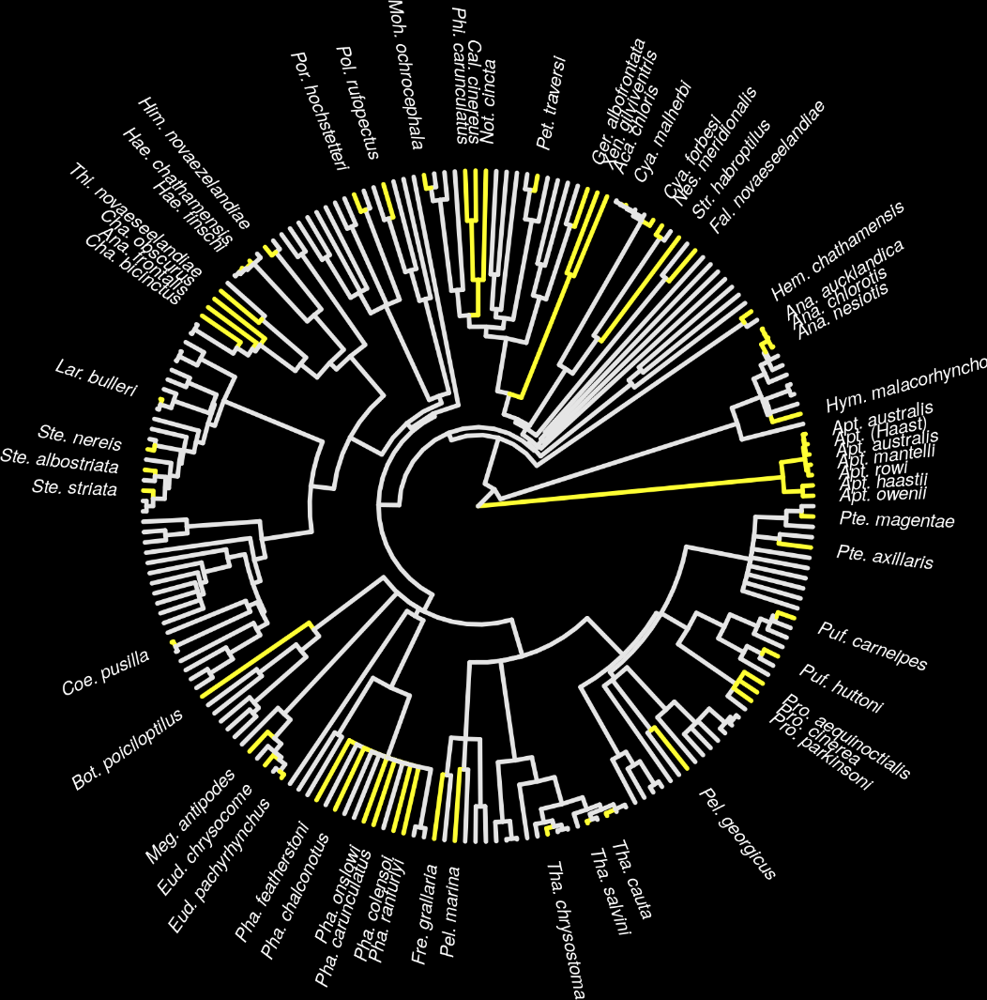
New Zealand case study
Projects for 62 imperiled bird species
1,218 different actions
Many actions shared between projects for different species
Hanson et al. 2019 Methods Ecol Evol

Slide 21
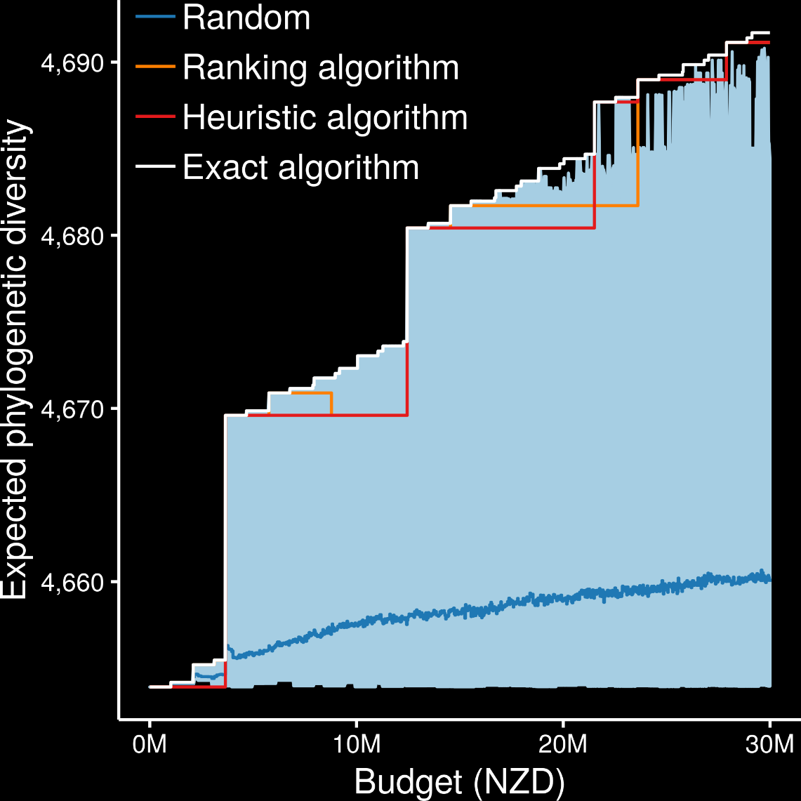
Exact algorithms always best
Ranking and heuristic algorithms sometimes produced optimal plans
Randomly funding projects sometimes produced better plans than ranking and heuristic algorithms
oppr R package
Hanson et al. 2019 Methods Ecol Evol

Slide 22
How can we get a better conservation decision?
(1) Better algorithms
(2) Better data
(3) Better surrogates

Slide 23
Ecological surveys
Distribution maps
Priority areas
Biodiversity
2000
Future
Data
Information
Plan
Outcome
Objectives
Constraints
Notes:
23

Slide 24

Ecological surveys
Distribution maps
Priority areas
Biodiversity
2000
Future
Data
Information
Plan
Outcome
Better
understanding
of biodiversity
Better
plan
Better
outcome
Genetic samples
Objectives
Constraints
Notes:
24

Slide 25
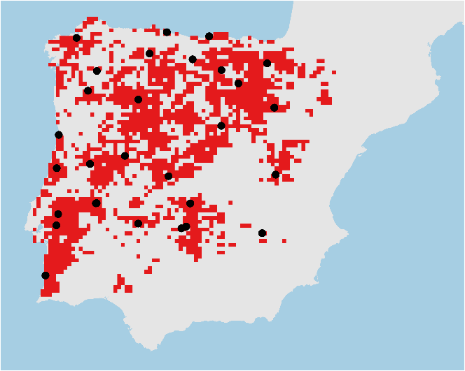
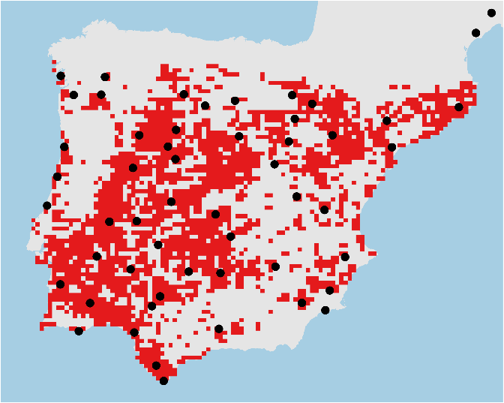
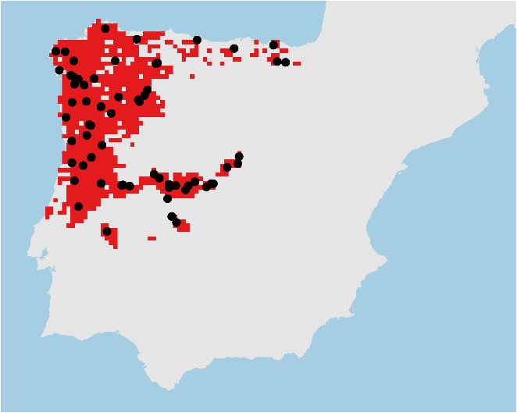

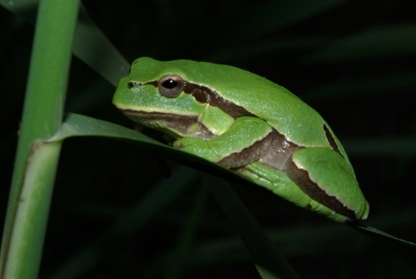
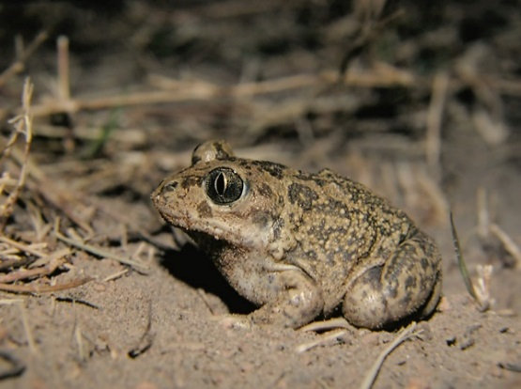
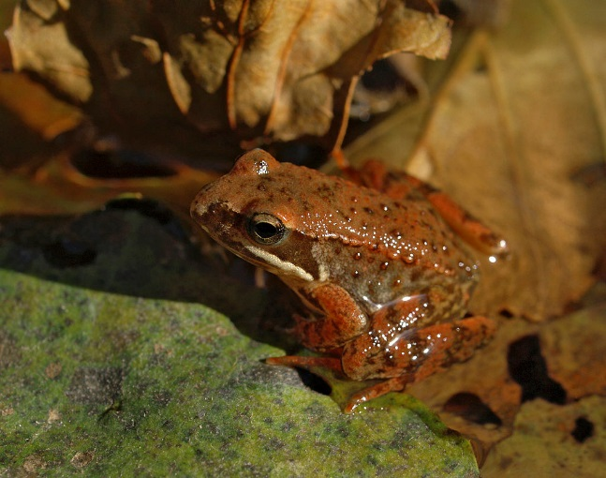
Conservation planning for adaptive and neutral evolutionary processes
Hyla molleri
Pelobates cultripes
Rana iberica
Hanson et al. 2020 J Appl Ecol

Slide 26
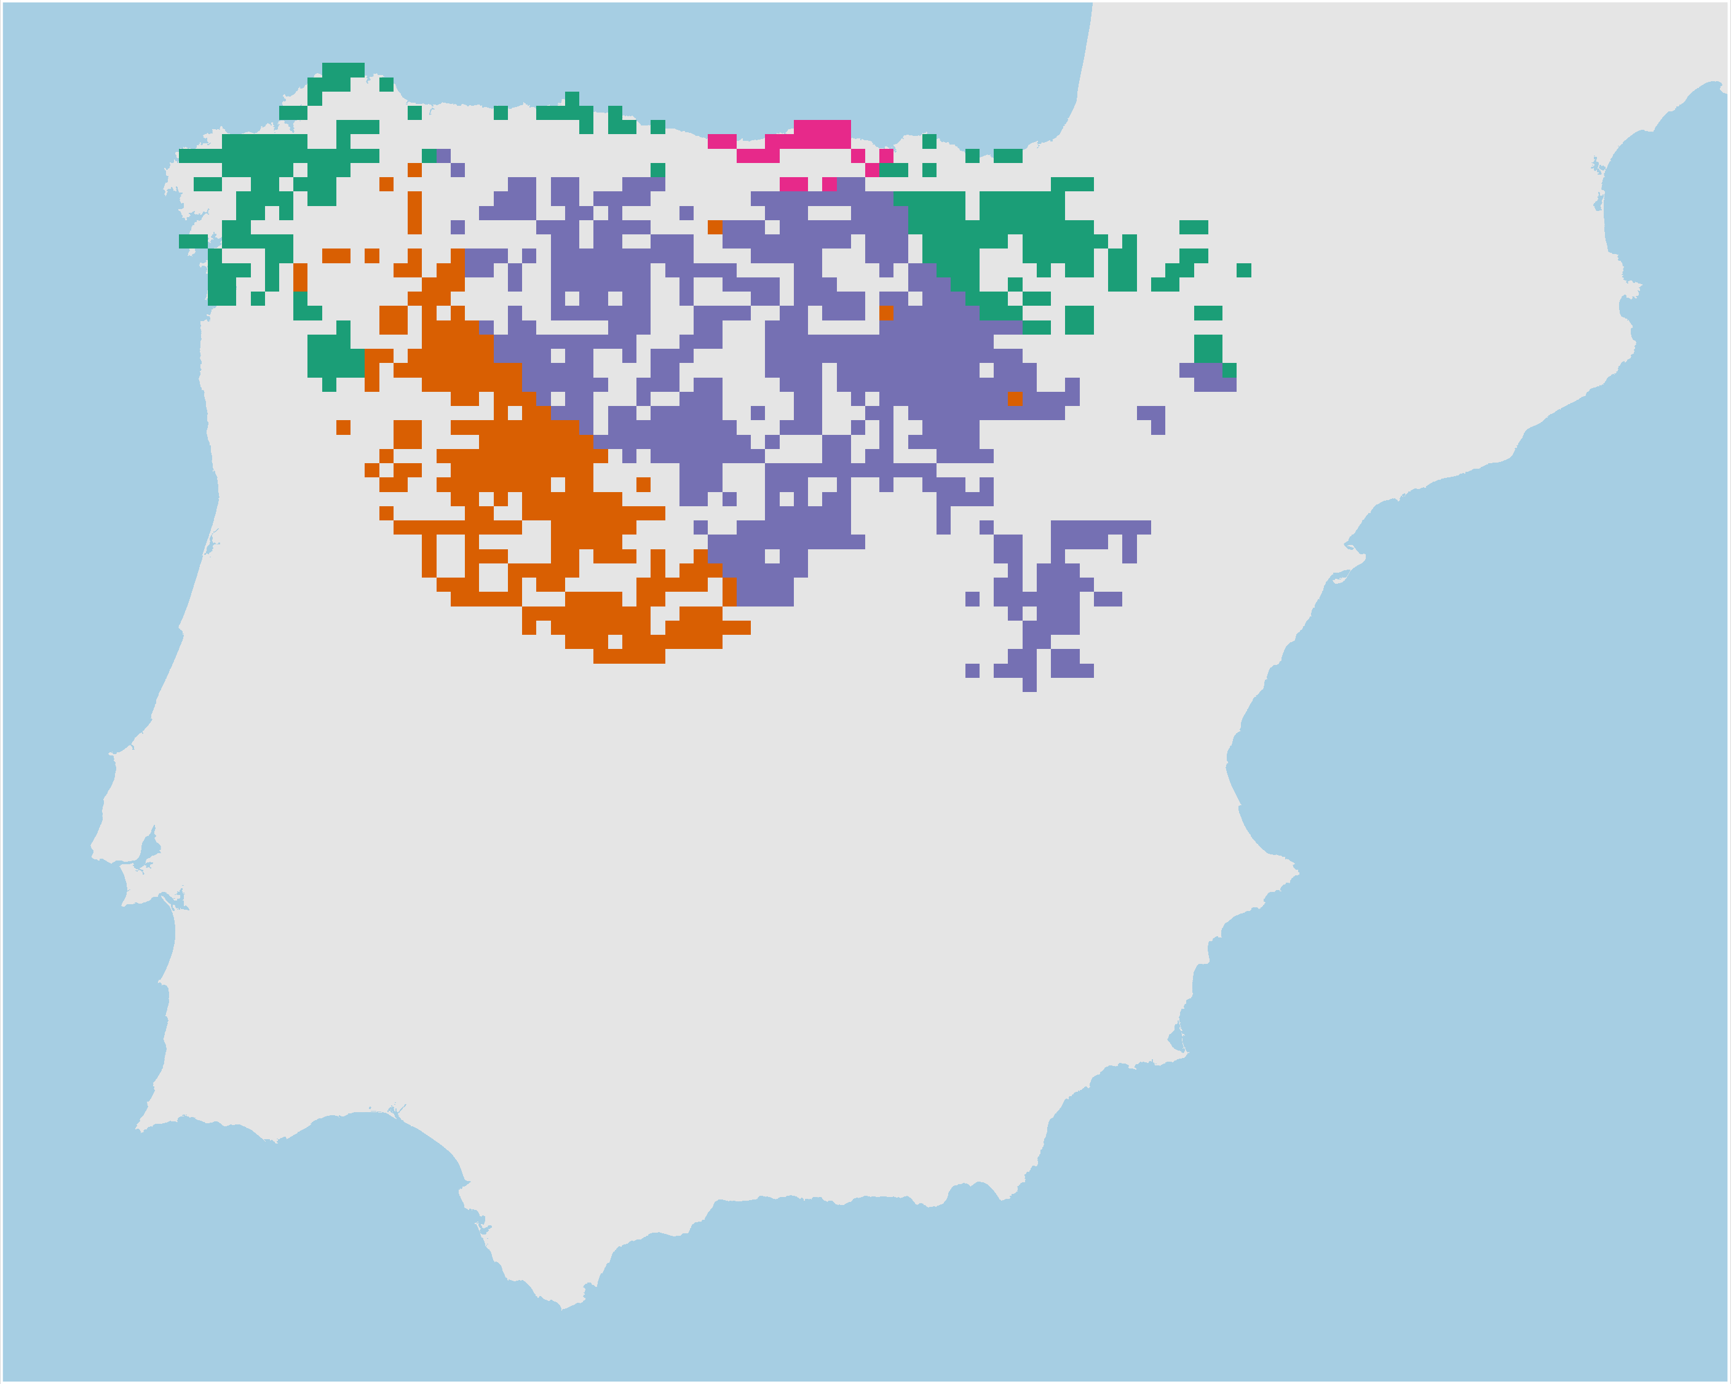
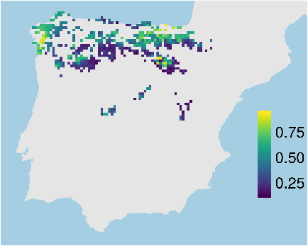
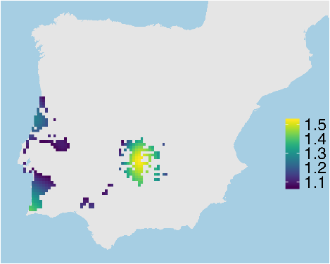
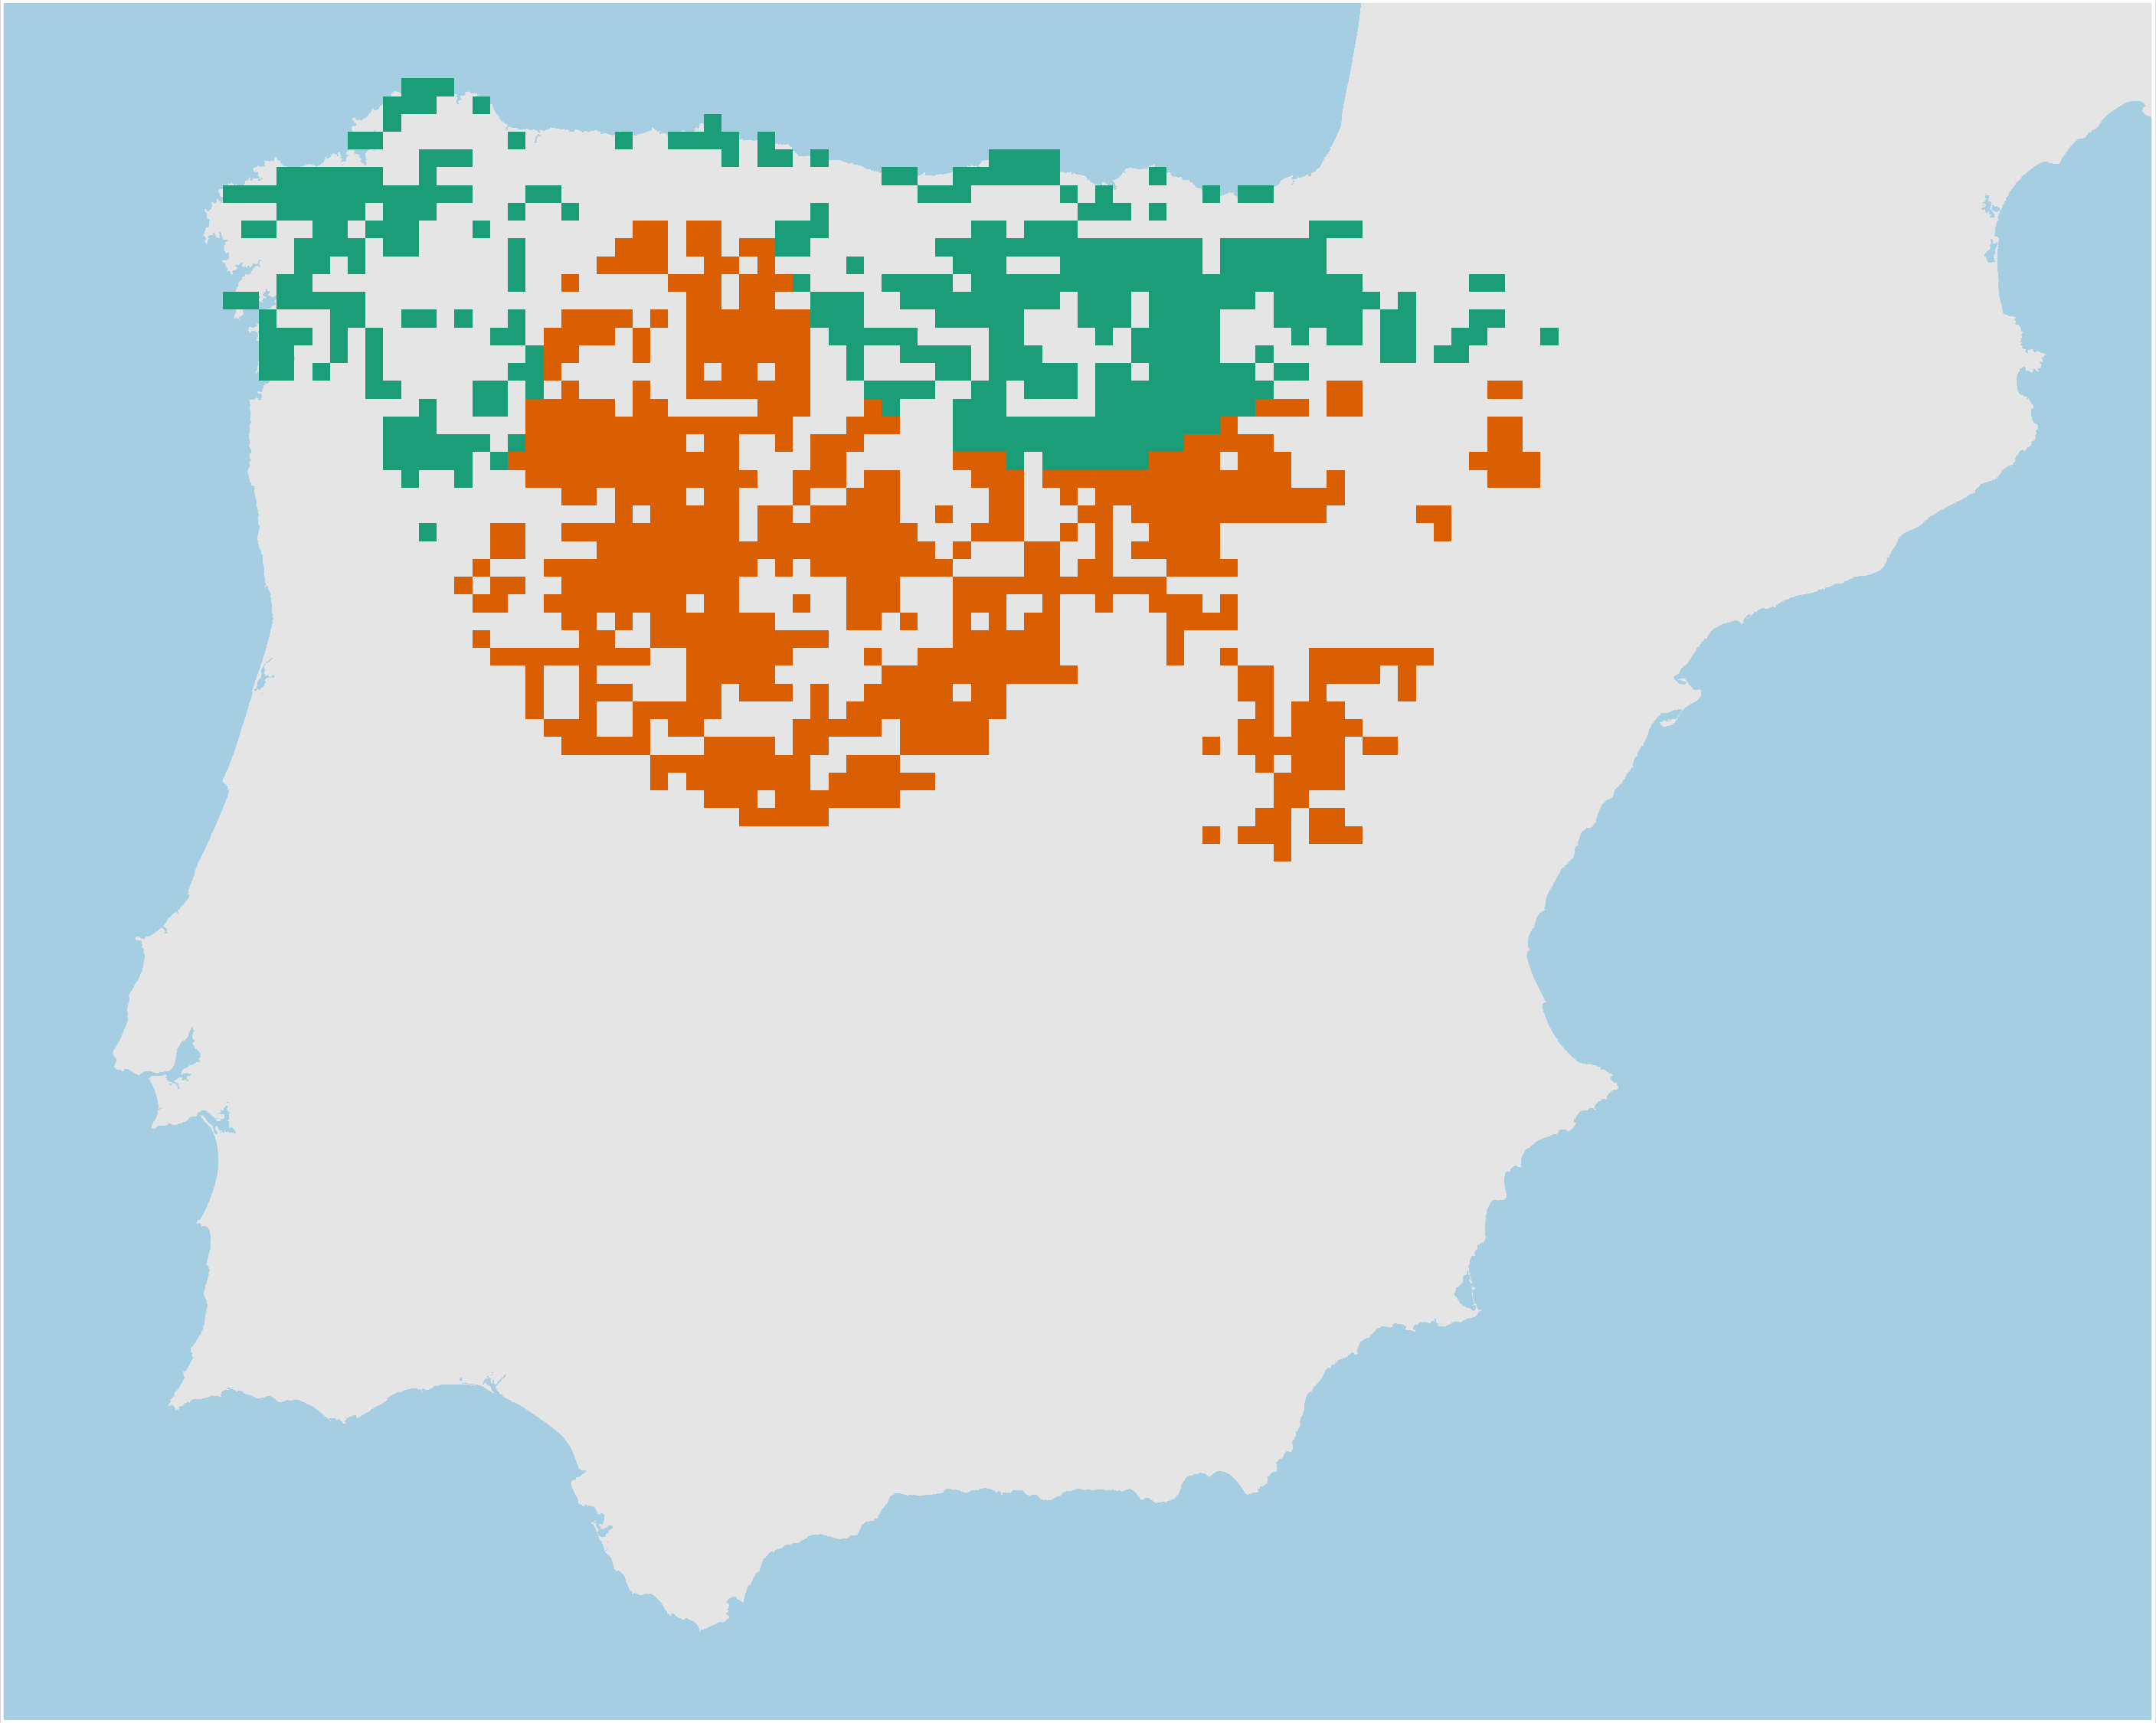
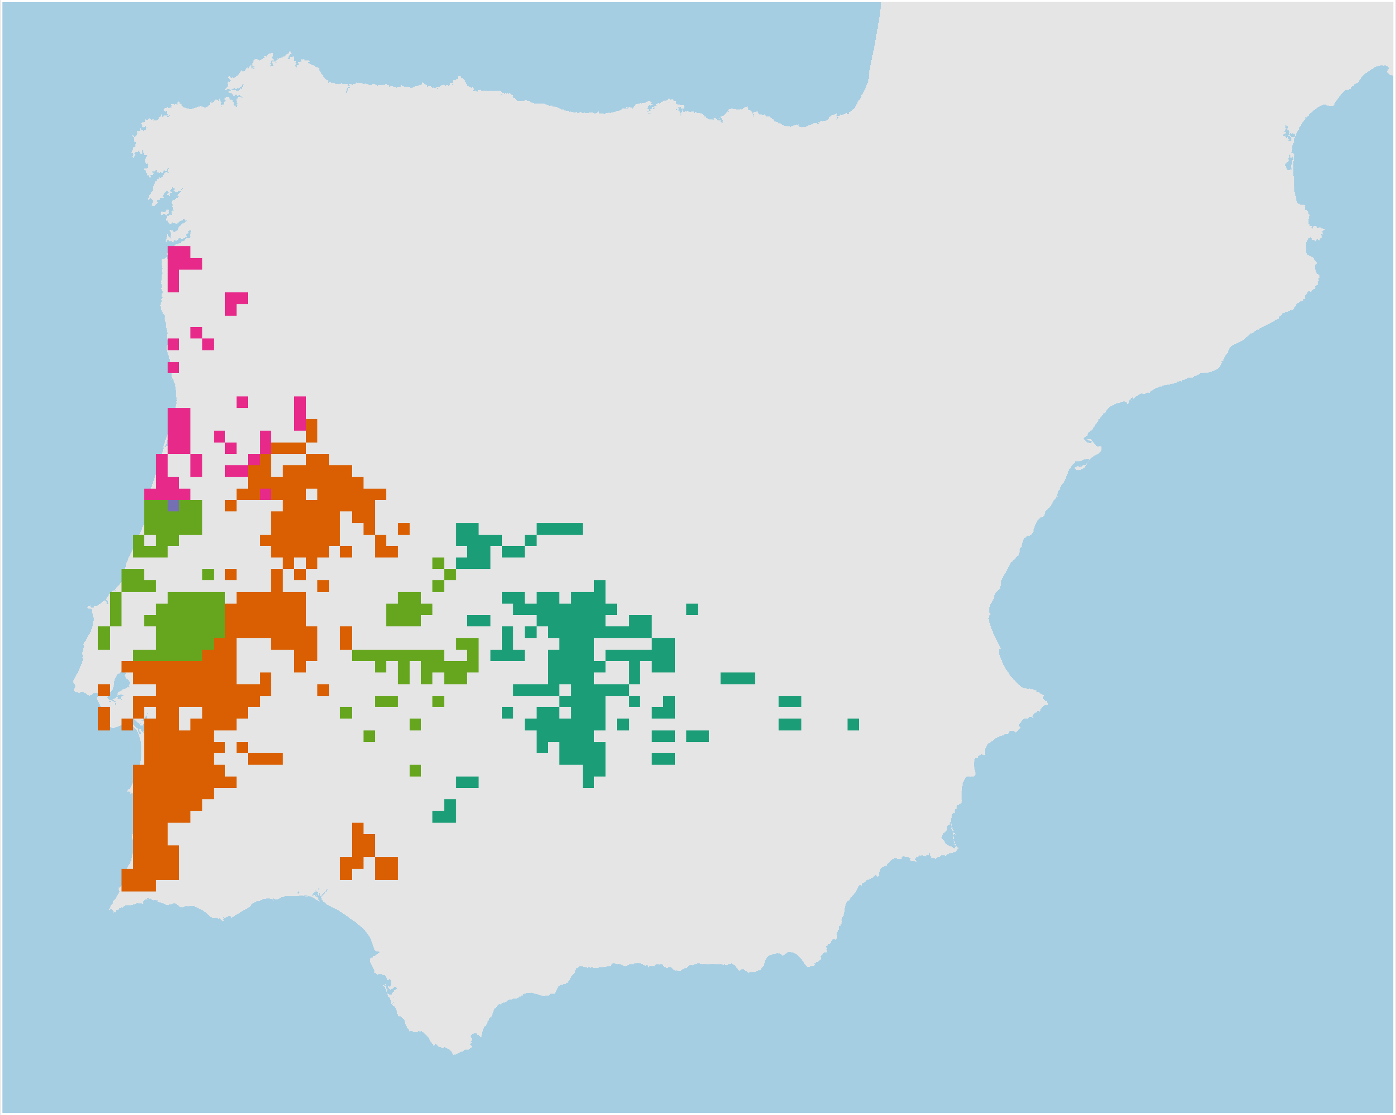
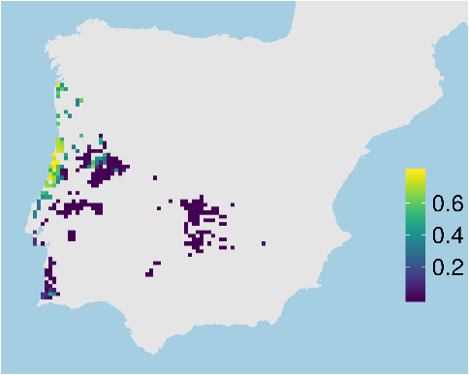
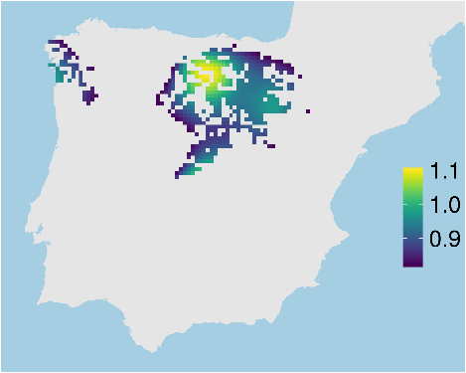
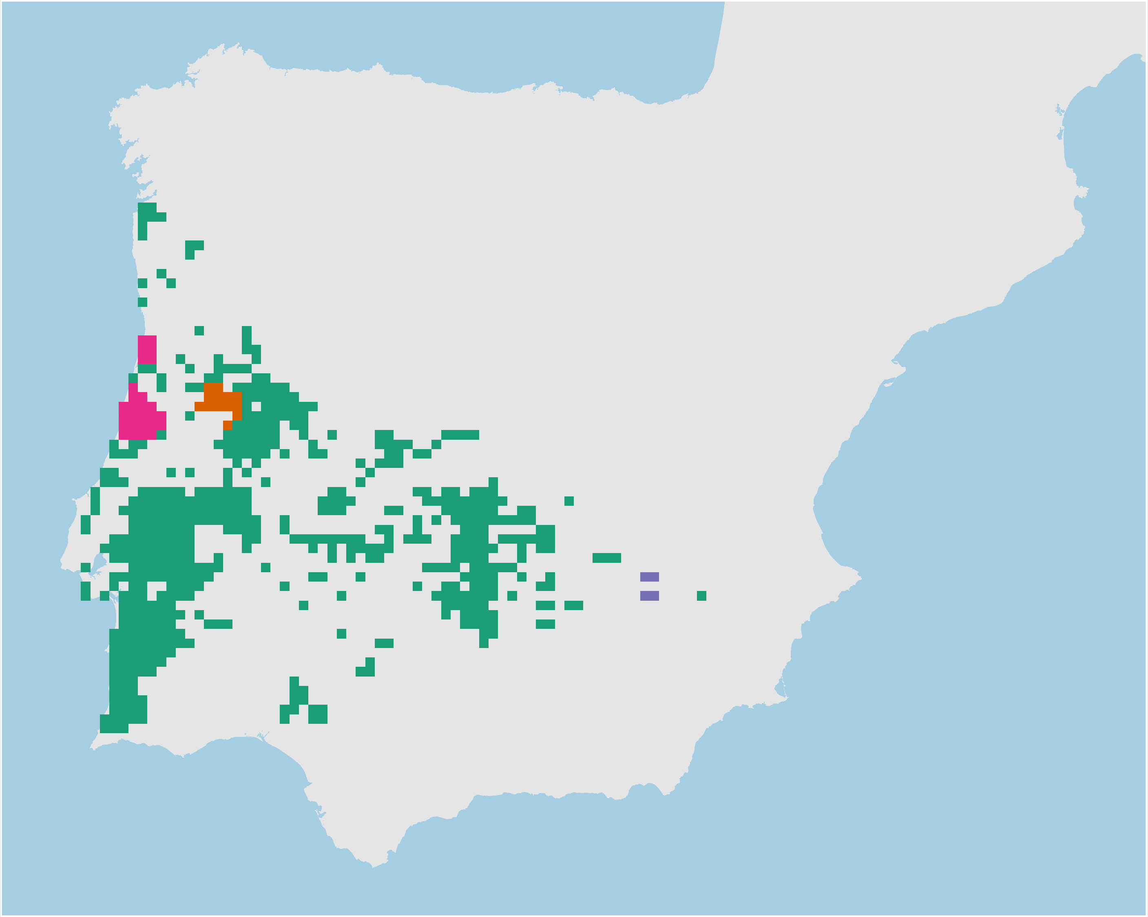
Adaptive processes
Neutral processes
Hyla molleri
Adaptive
clusters
Climate
refugia
Individual
heterozygosity
Neutral
clusters
Hanson et al. 2020 J Appl Ecol

Slide 27
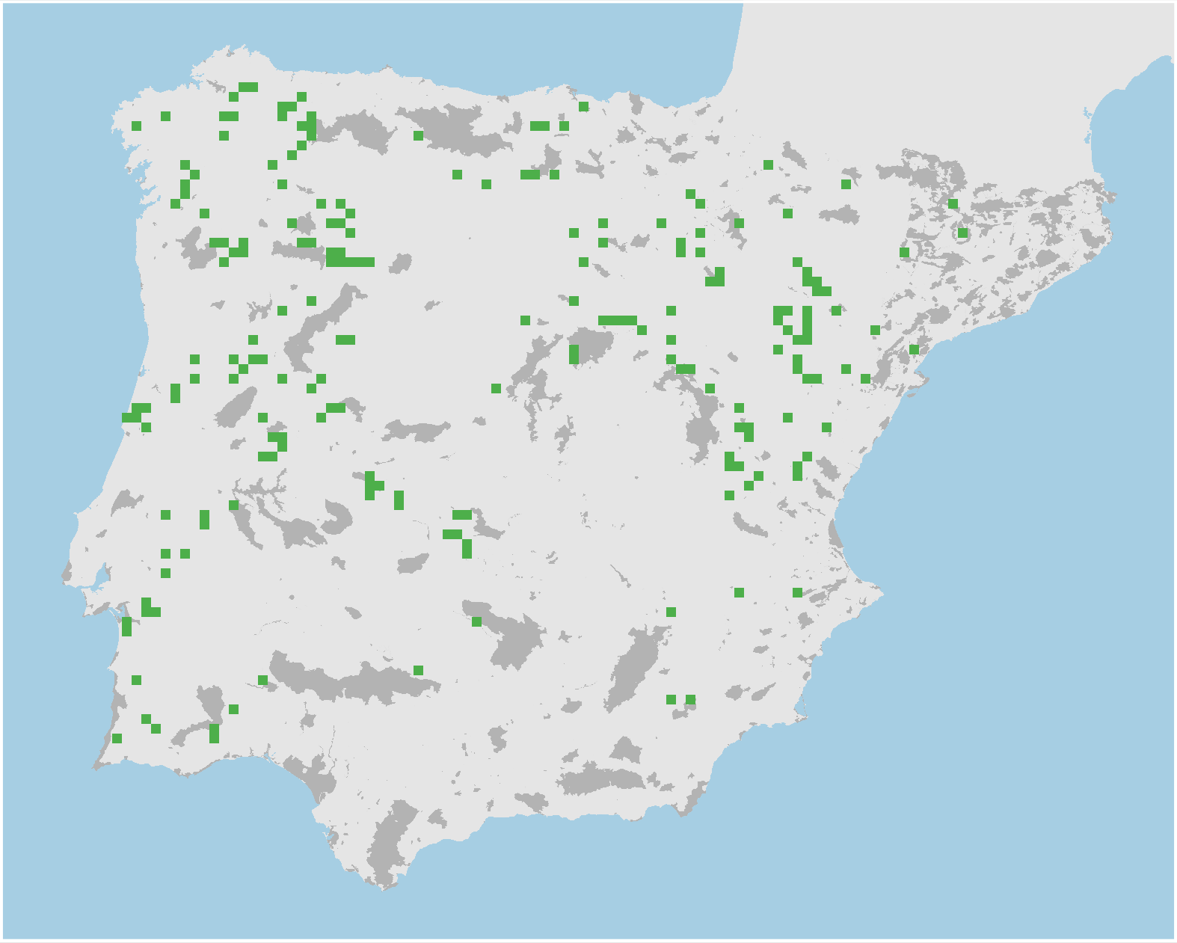
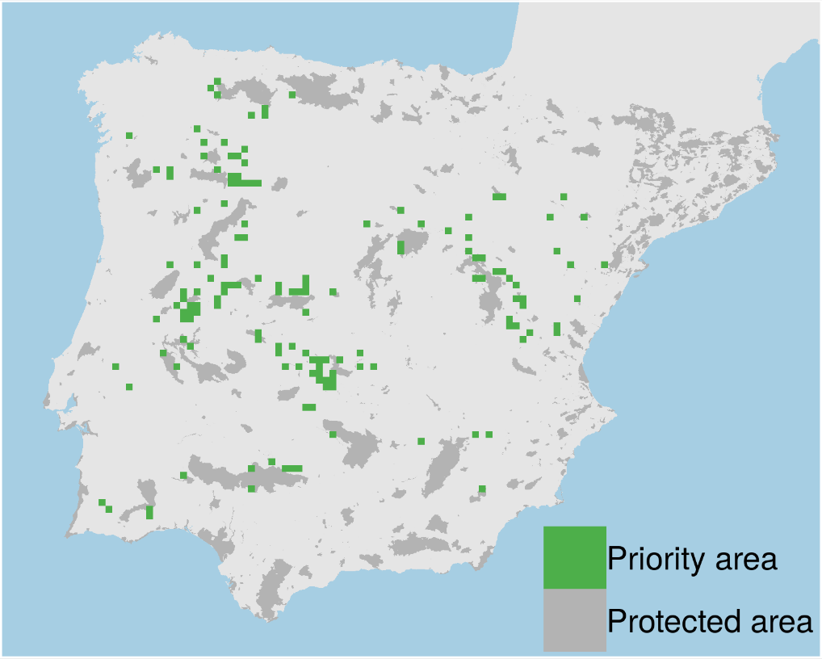
Prioritizations
Plan with evolutionary processes
Conventional plan
Only costs 9% less
Hanson et al. 2020 J Appl Ecol

Slide 28
However, more data isn’t always better…

Slide 29
Ecological surveys
Distribution maps
Priority areas
Biodiversity
2000
Future
Data
Information
Plan
Outcome
Objectives
Constraints

Slide 30
Ecological surveys
Distribution maps
Priority areas
Biodiversity
?
?
?
?
?
?
2000
Future
Data
Information
Plan
Outcome
More
surveys
Better
models
Better
management
Better
outcome
Objectives
Constraints

Slide 31
Ecological surveys
Distribution maps
Priority areas
Biodiversity
?
?
?
?
?
?
?
?
?
?
?
?
2000
Future
Data
Information
Plan
Outcome
More
surveys
Better
models
Poorer
management
Worse
outcome
Objectives
Constraints
Less funding

Slide 32
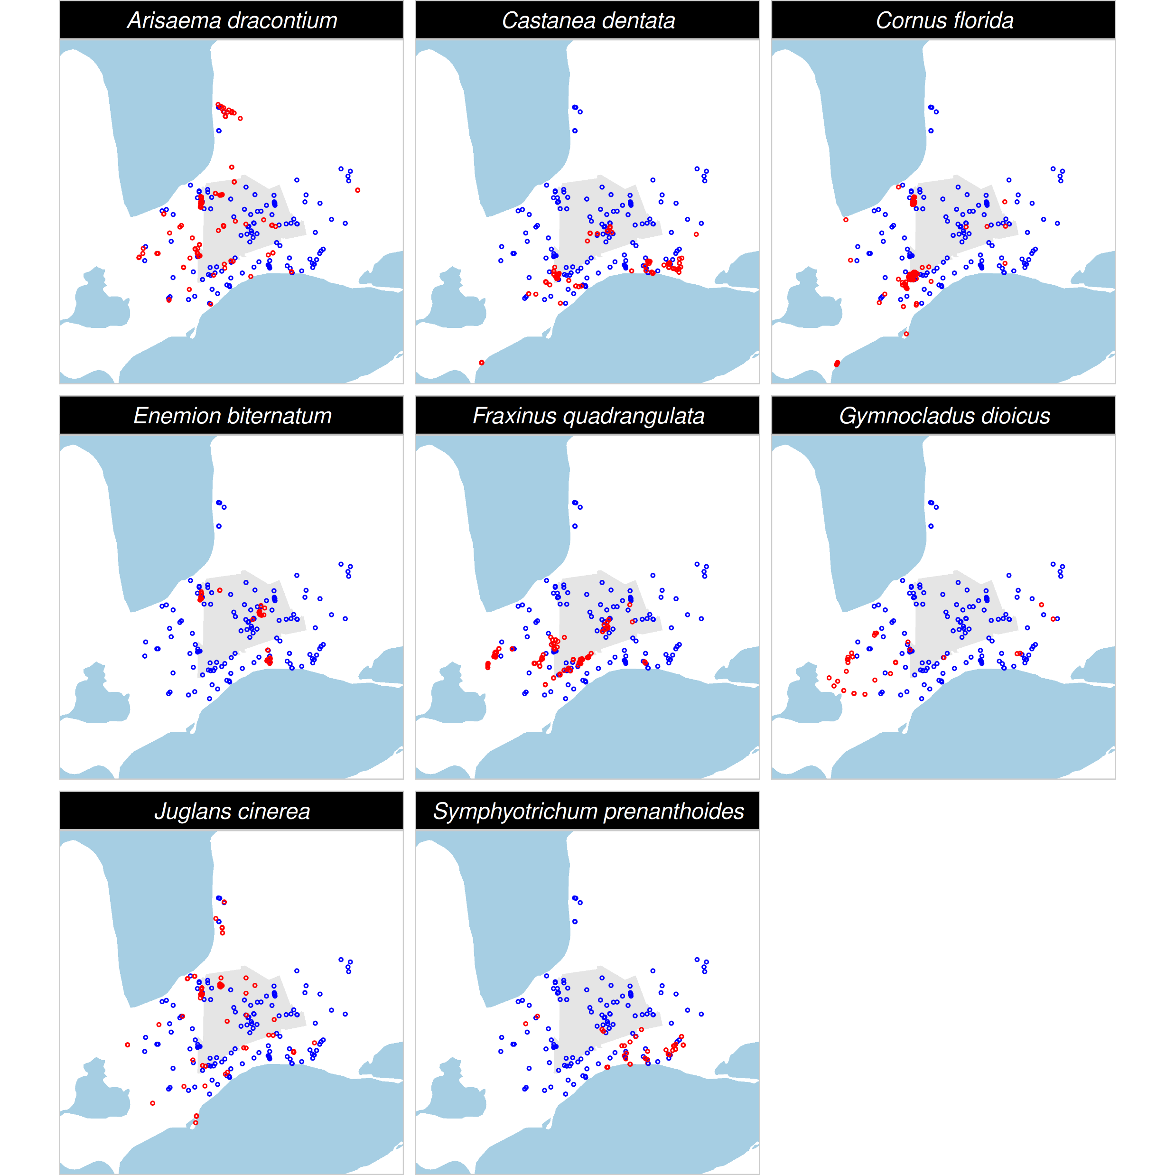
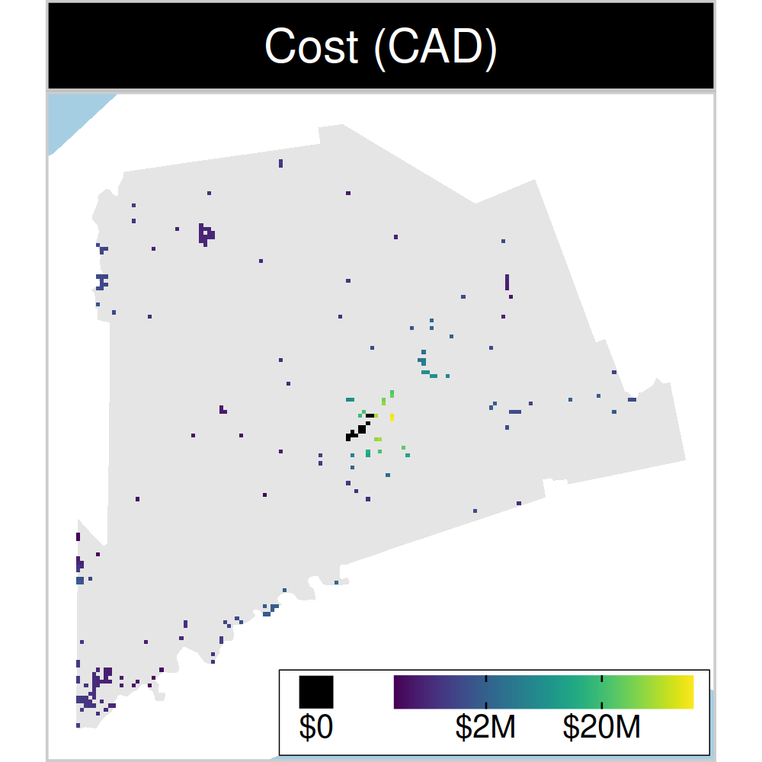
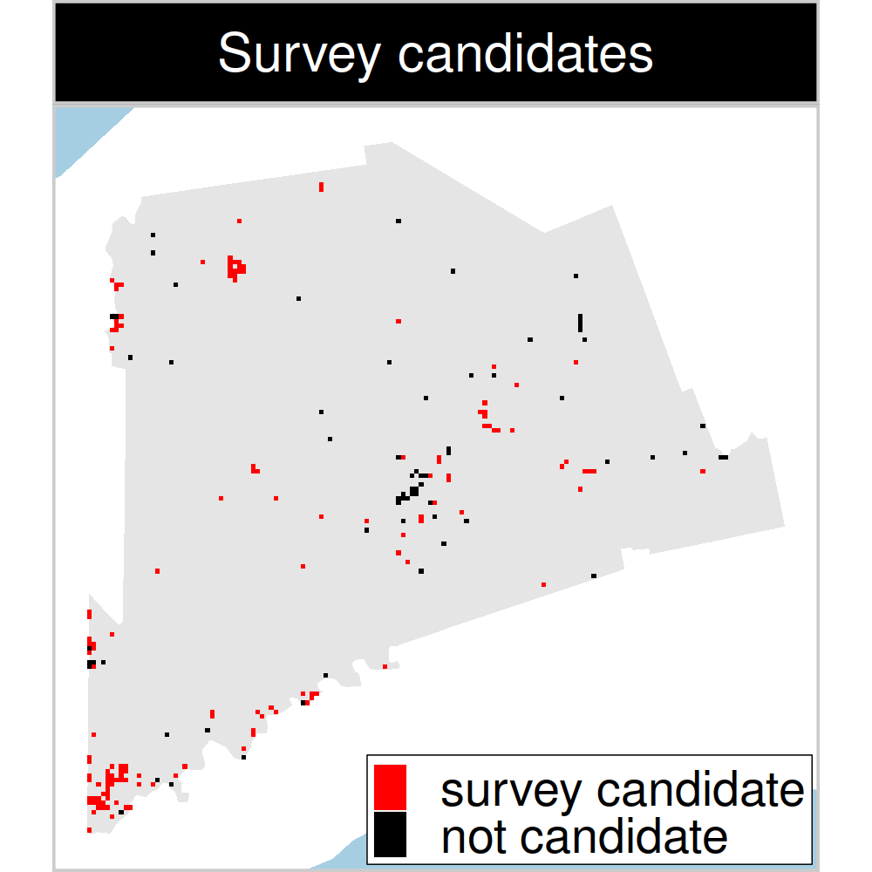
Study system: Middlesex country, Canada
199 places that could
potentially be acquired for
protected area establishment
143 places that could potentially be surveyed to
improve existing data
8 imperilled plant species
Hanson et al. under review
Notes:
32

Slide 33
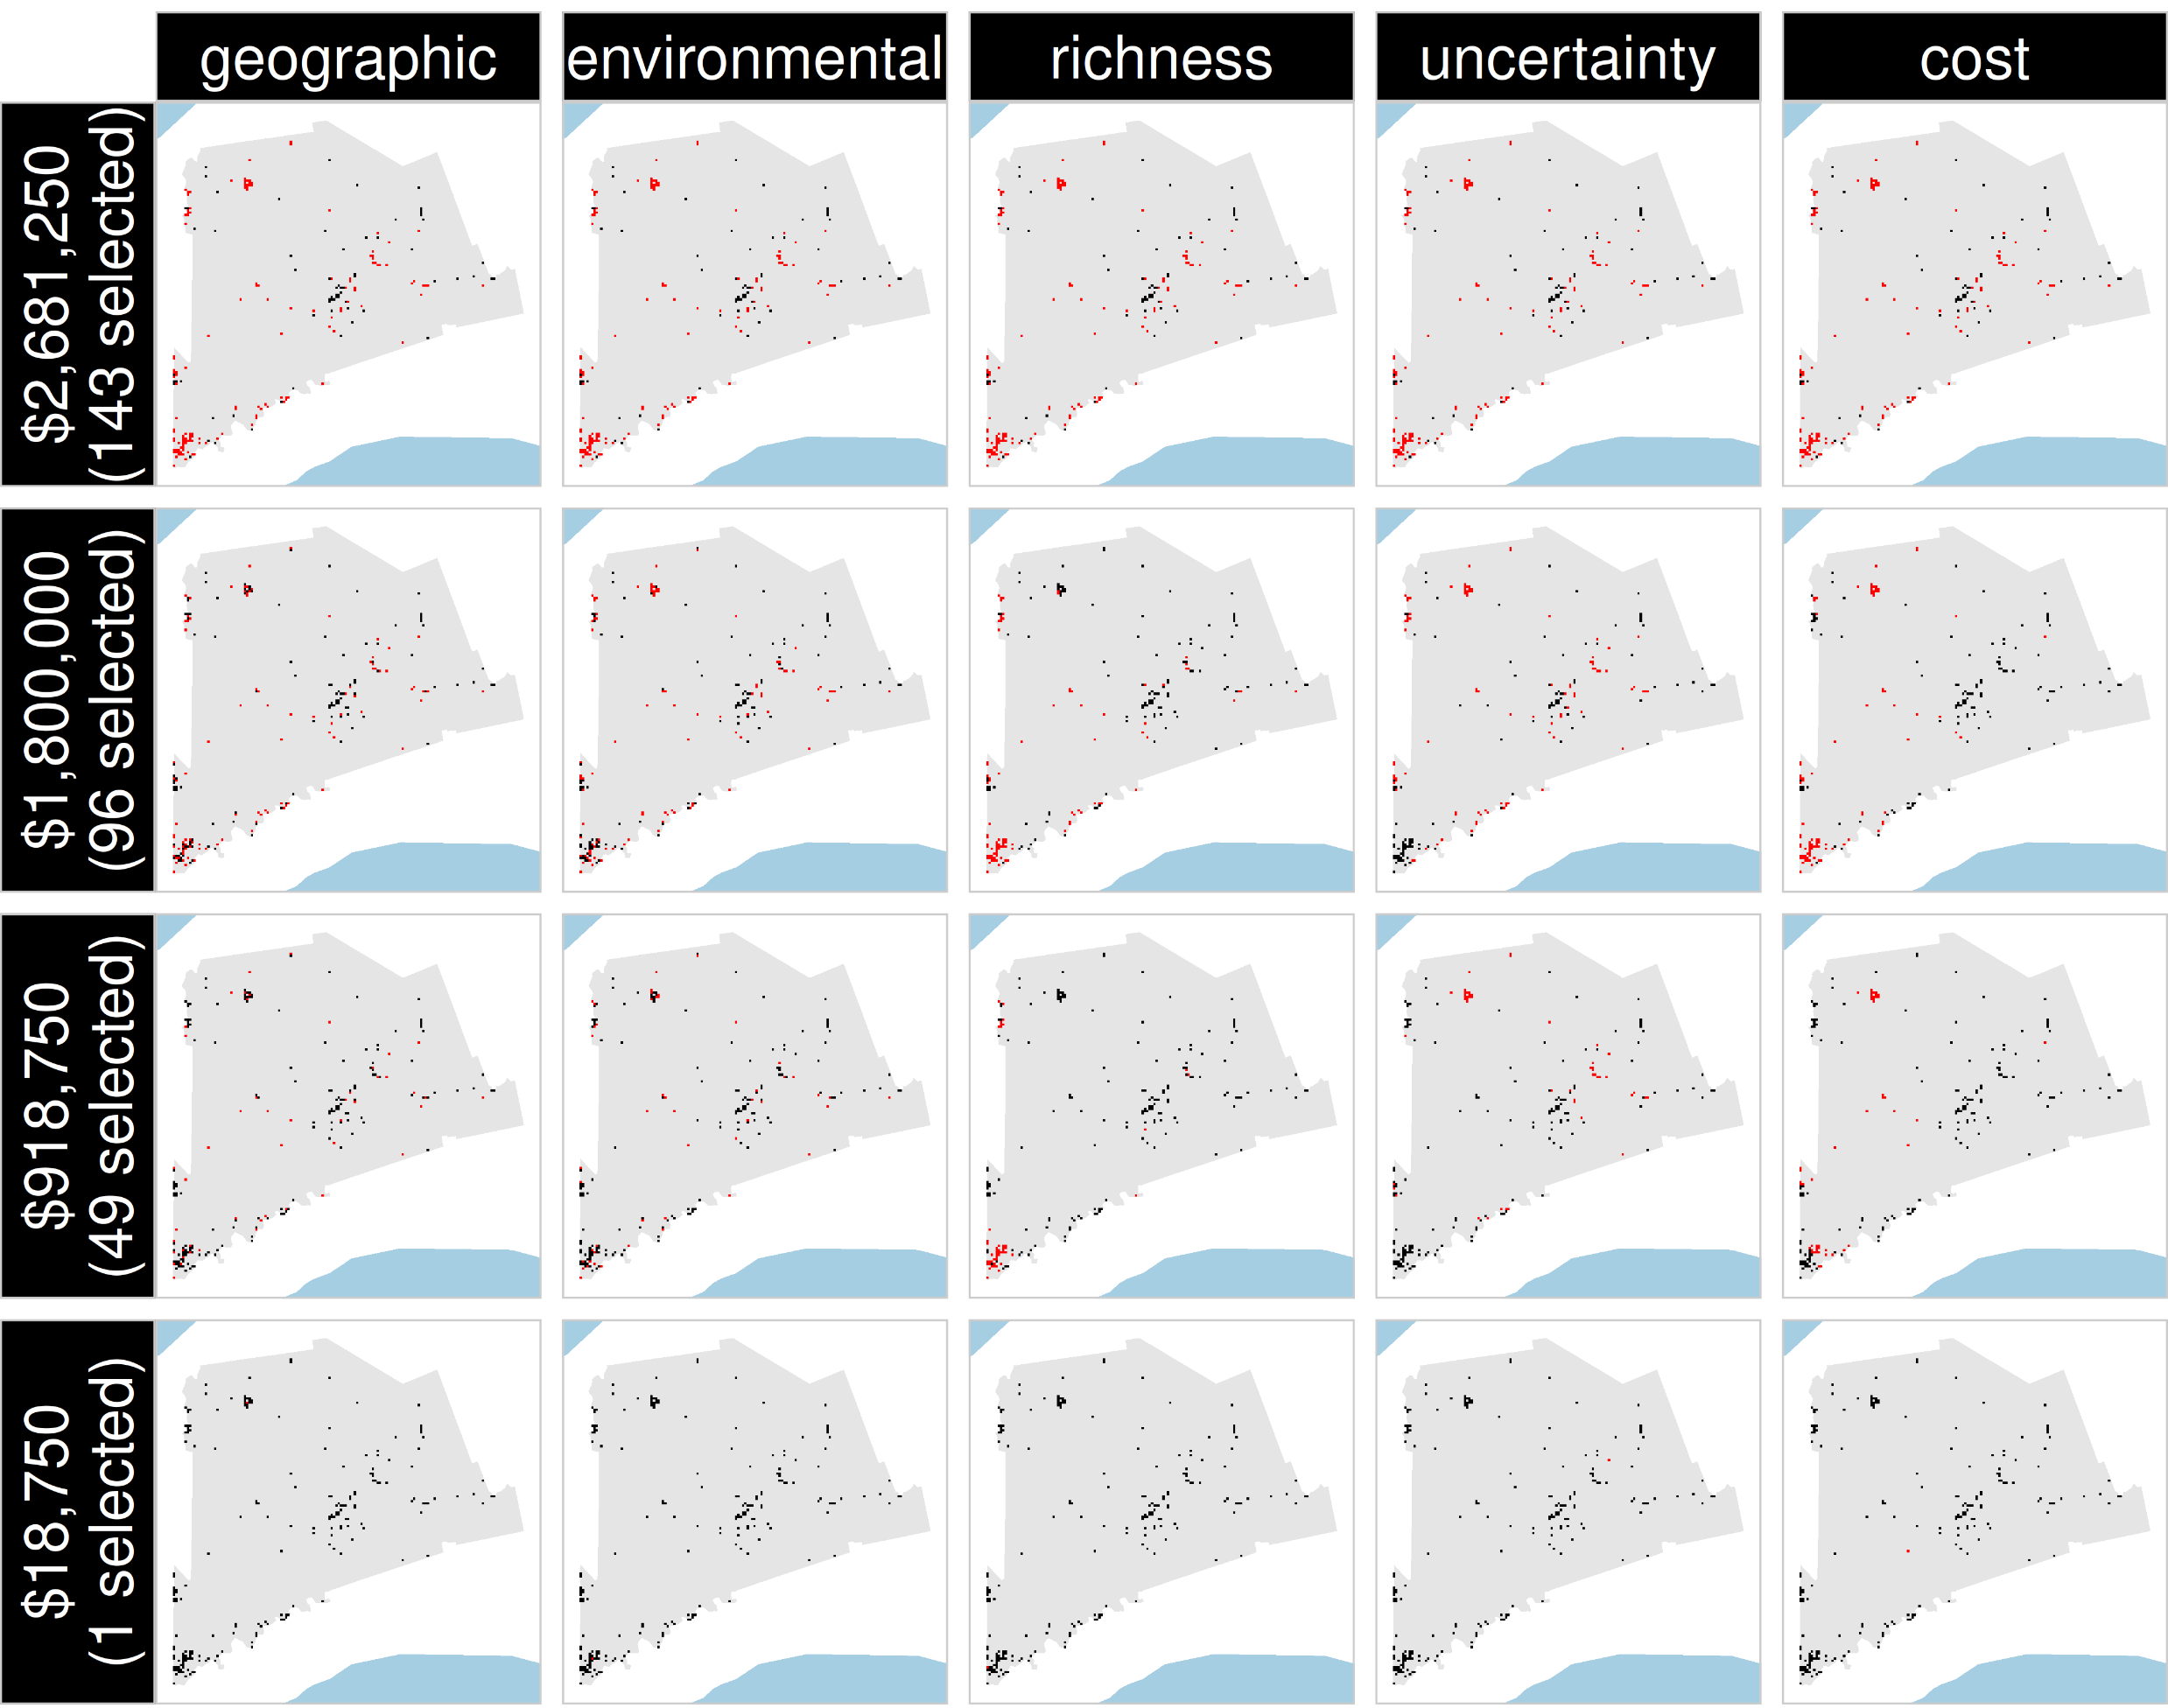
Selected
for survey
Number of places selected for surveys
(amount of funds allocated for collecting extra data)
NOT selected
for survey
Different approaches for designing survey schemes

Slide 34
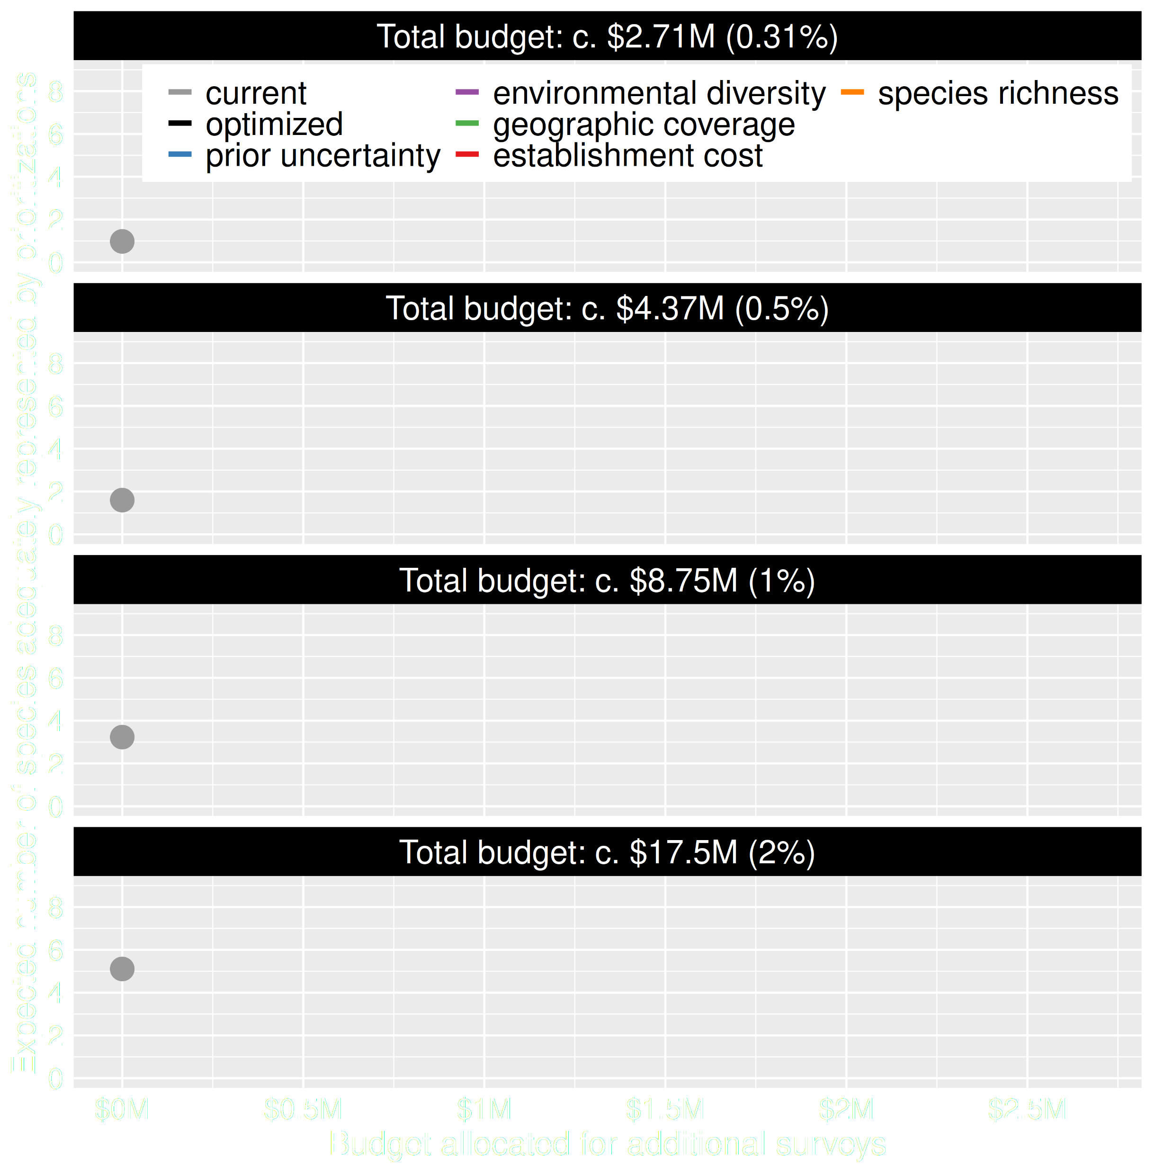
Value of information
Using existing data could lead to positive outcomes
More fundings could mean better outcomes
Hanson et al. under review

Slide 35
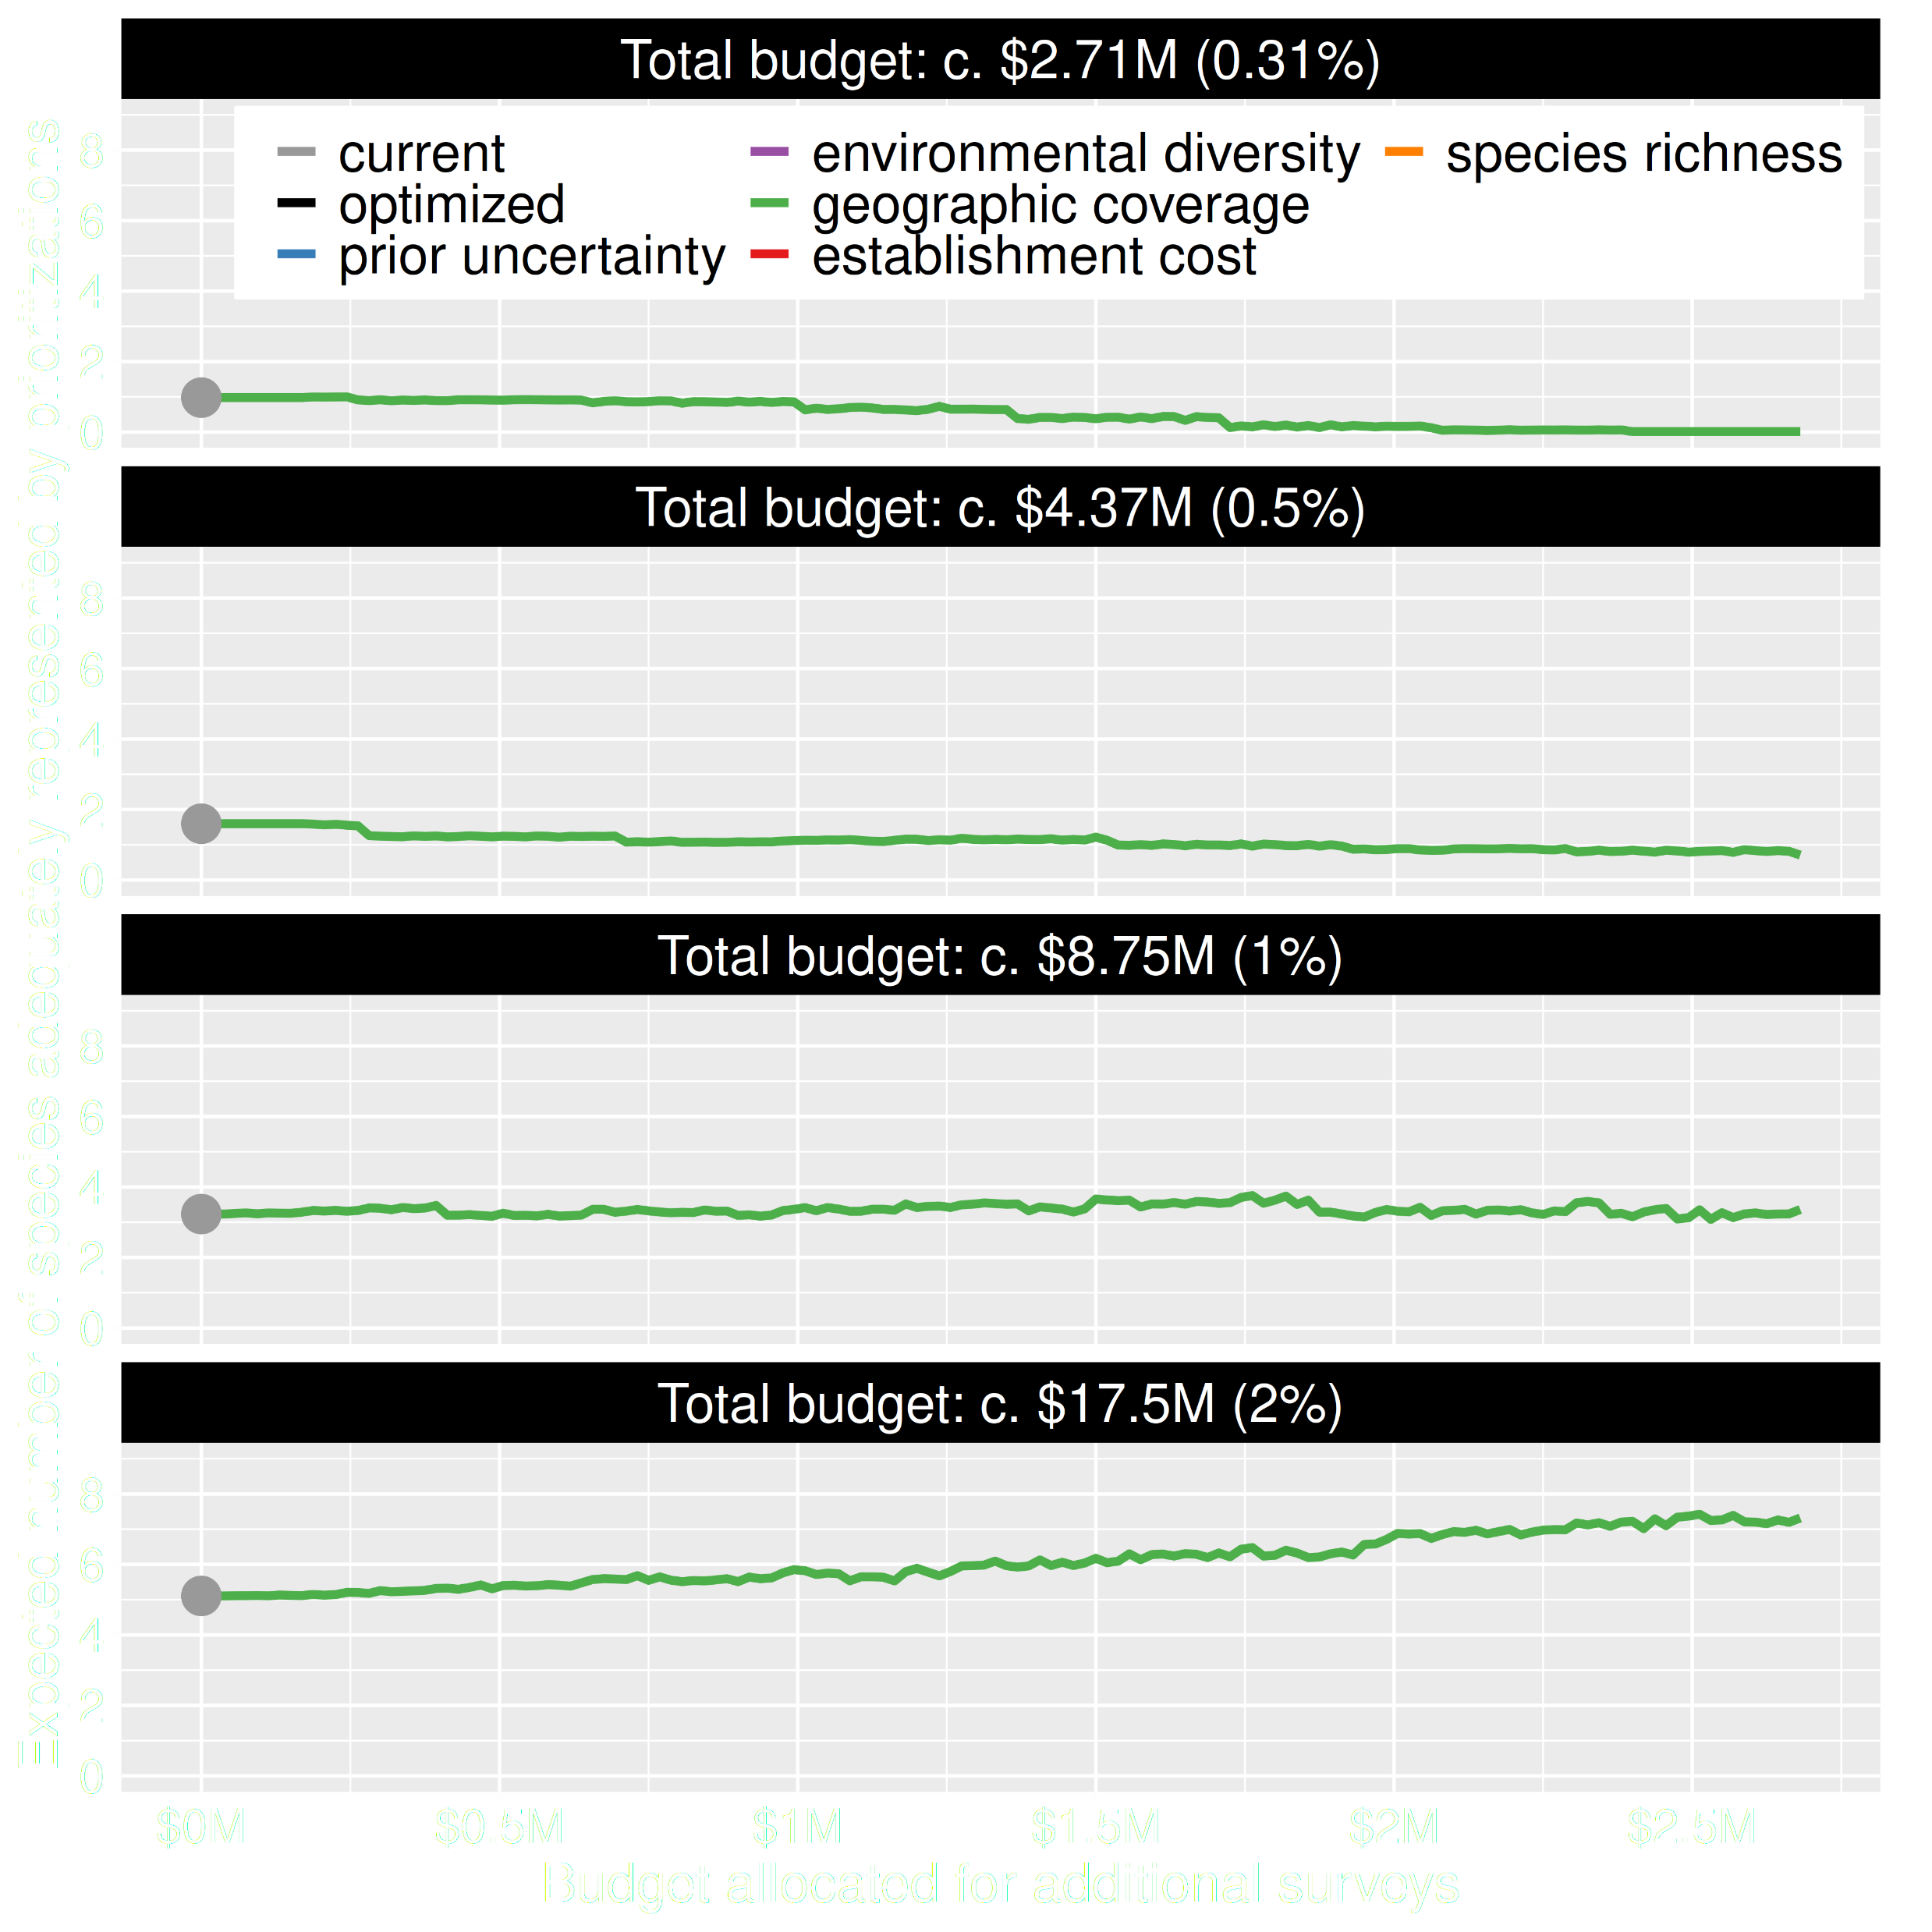
Value of information
Allocating funds for data collection can mean worse outcomes
Allocating funds for data collection can mean better outcomes too
Hanson et al. under review

Slide 36
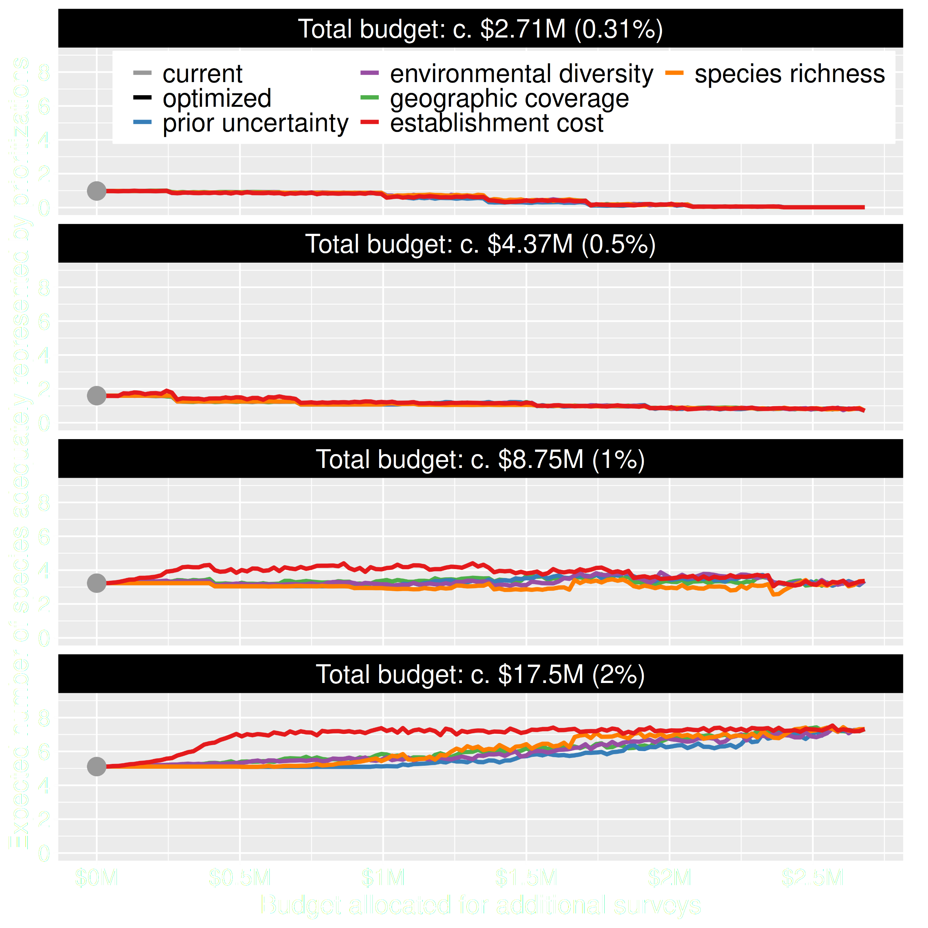
Value of information
Different conventional approaches have different performance
Performance of these approaches depends on available funds
All of them could lead to lead to worse outcomes

Slide 37
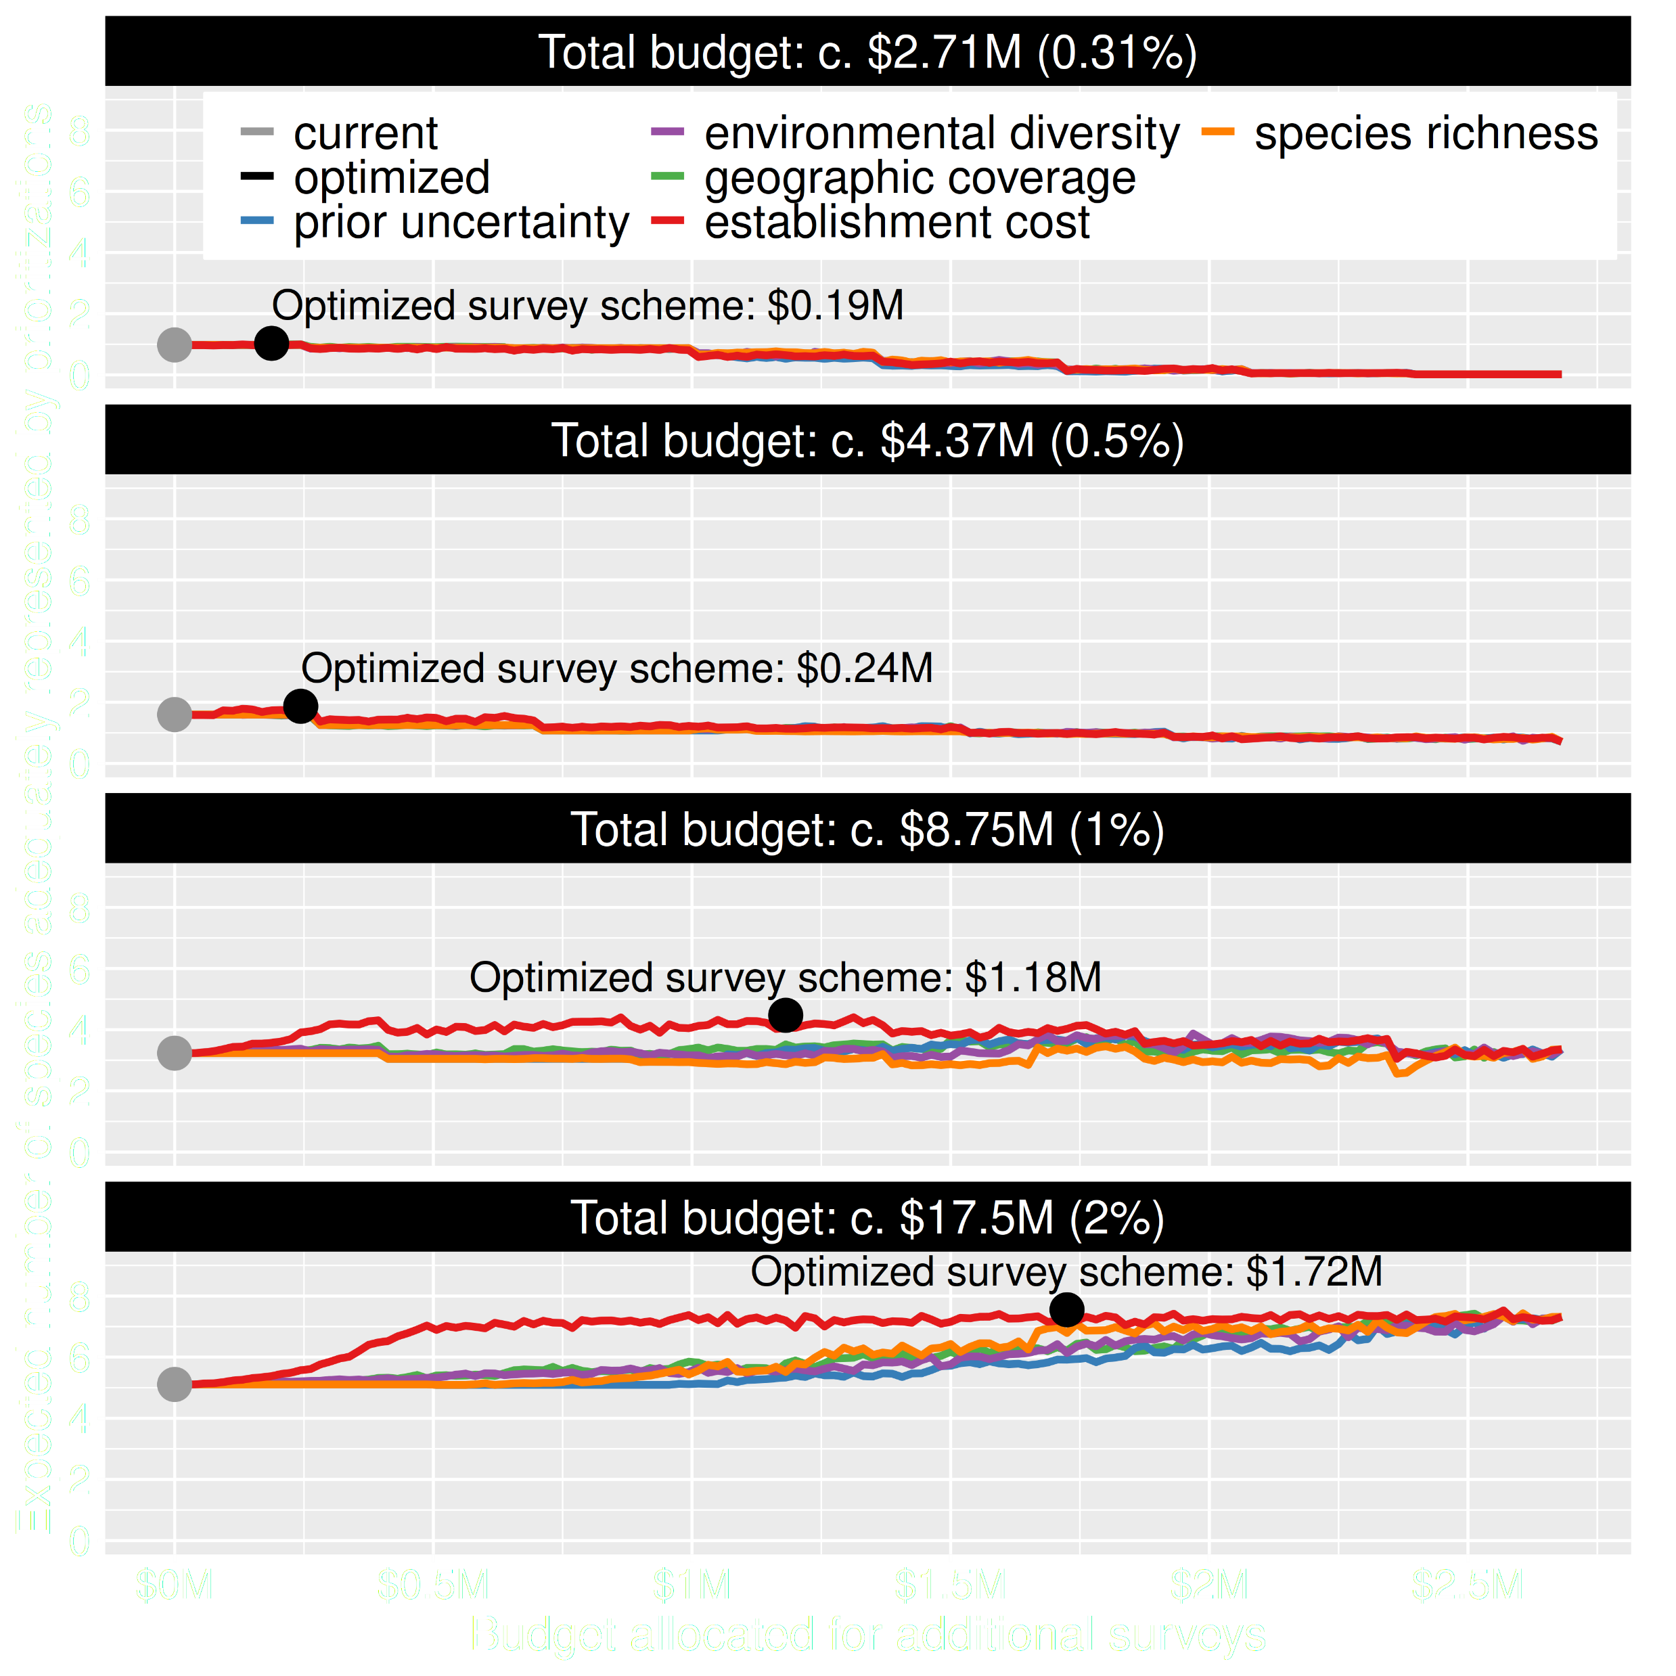
Value of information
Maximizing return on investment is best
This considers objectives and constraints that underpin conservation plans and their success
surveyvoi R package
Hanson et al. under review

Slide 38
How can we get a better conservation decision?
(1) Better algorithms
(2) Better data
(3) Better surrogates

Slide 39
Evolutionary processes
Species range
Population

Slide 40
Evolutionary processes
Species range
Population

Slide 41
Evolutionary processes
Species range
Population

Slide 42
Evolutionary processes
Species range
Population

Slide 43
Ecological surveys
Distribution maps
Priority areas
Biodiversity
2000
Future
Data
Information
Plan
Outcome
Better
understanding
of biodiversity
Better
plan
Better
outcome
Genetic samples
Objectives
Constraints
Notes:
43

Slide 44
Ecological surveys
Distribution maps
Priority areas
Biodiversity
2000
Future
Data
Information
Plan
Outcome
Good enough
understanding
of biodiversity
Better
plan
Better
outcome
Environment data
Cold
Objectives
Constraints
Hot
Notes:
44

Slide 45
Can we use environmental and geographic variables as surrogates of genetic variation for conservation planning?

Slide 46
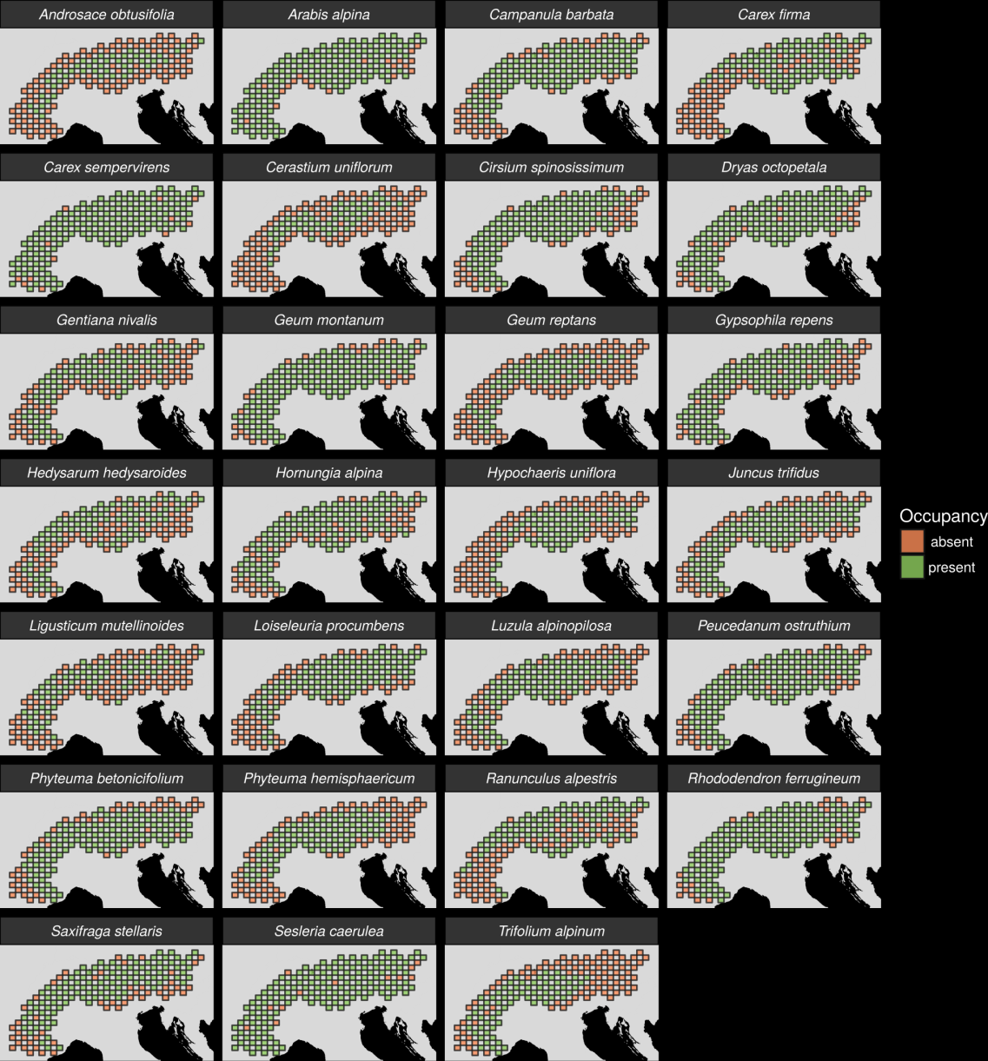
27 plant species
Different dispersal
Different life-histories
Different niches
AFLP markers
Hanson et al. 2017 PNAS

Slide 47
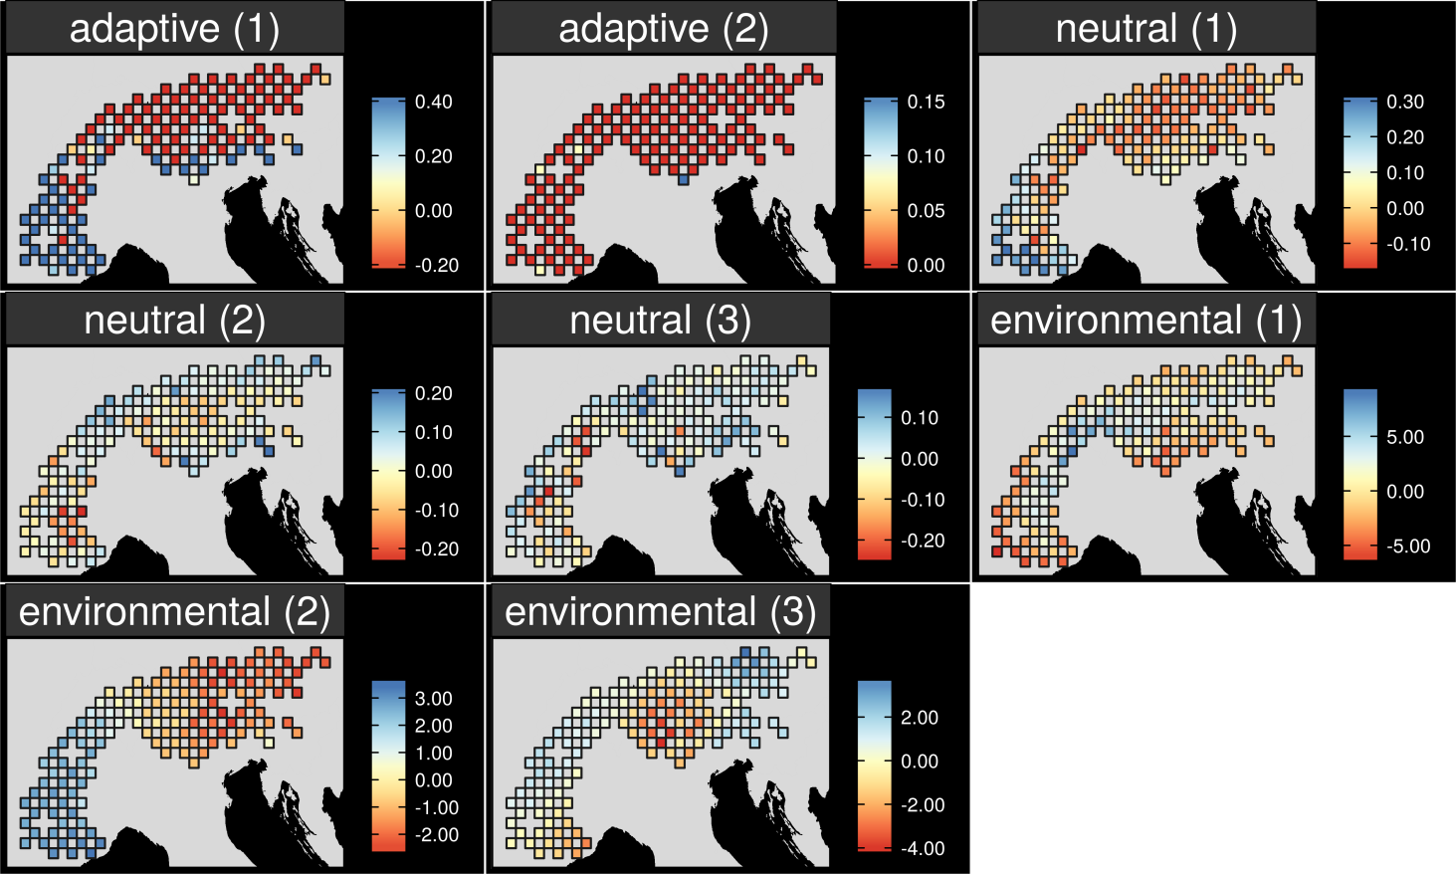
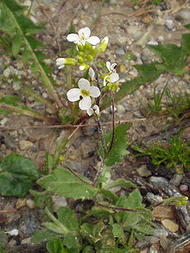
Map intra-specific variation
Arabis alpina
Hanson et al. 2017 PNAS
Notes:
47

Slide 48
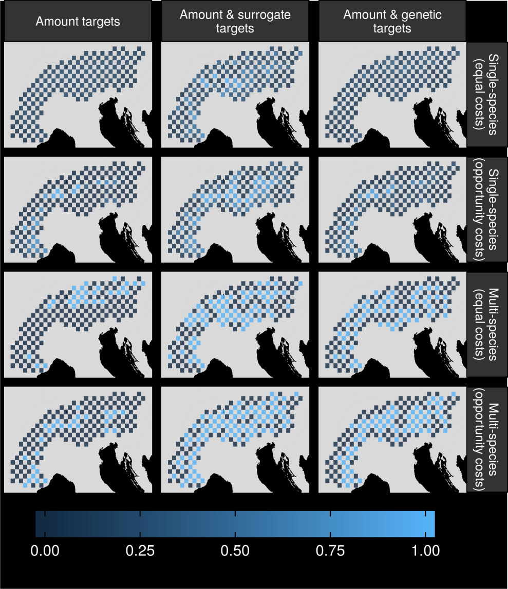
Can surrogates inform our decisions?
Hanson et al. 2017 PNAS

Slide 49
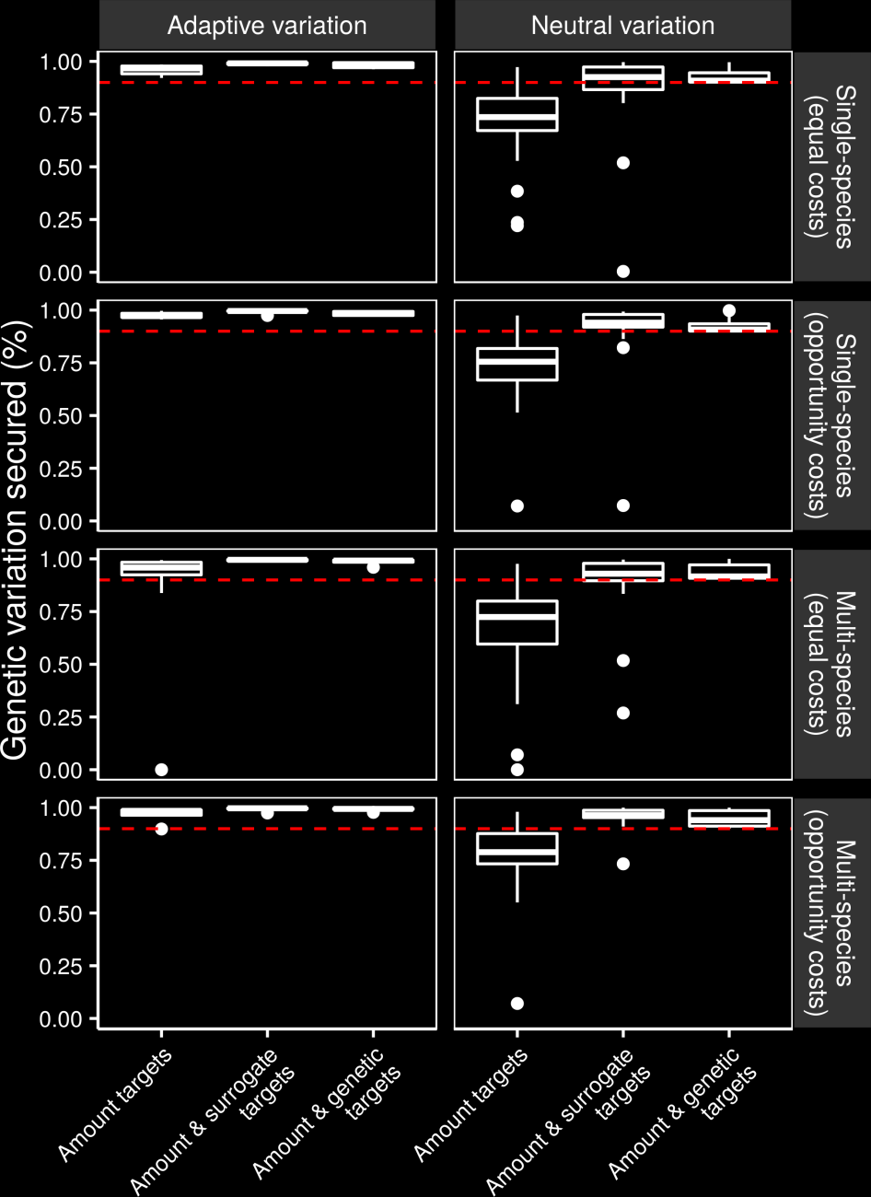
Can we make better decisions using surrogates?
Hanson et al. 2017 PNAS

Slide 50
Can we make better decisions using surrogates?
Hanson et al. 2017 PNAS

Slide 51
Assuming surrogates actually work, how can we use them to inform conservation globally?

Slide 52
Data
9,670 bird, 5,070 mammal, 5,197 amphibian species
5 × 5 km maps delineating suitable habitat
Subdivided each species’ spatial distribution into multiple “environmental partitions”
Set targets for each environmental partition for each species’ spatial distribution
Hanson et al. 2020 Nature

Slide 53
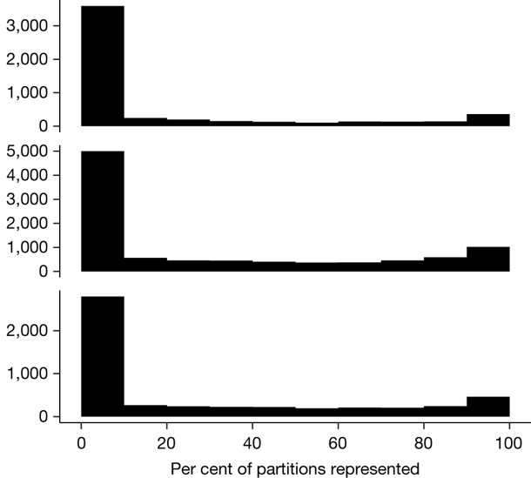
How good is the existing protected system?
18,097 (90%) species are not adequately represented in reserves
9,651 (48%) species do not have a single partition adequately represented
Of these, 2,385 species are globally imperilled
Amphibians
Birds
Number of species
Mammals
Hanson et al. 2020 Nature

Slide 54
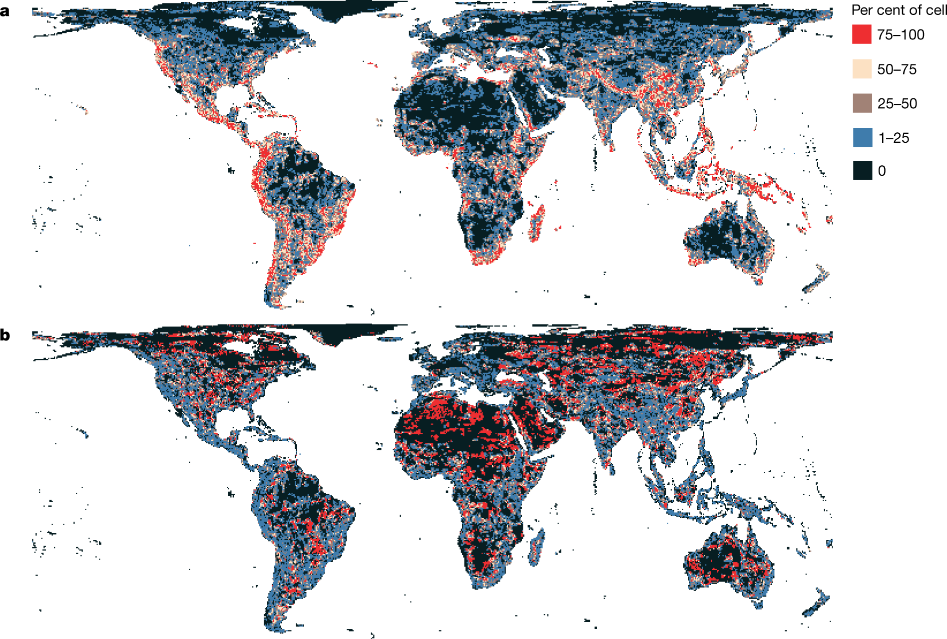
Prioritization
34% of Earth’s land and inland waters
Hanson et al. 2020 Nature

Slide 55
However, surrogates may not always work

Slide 56
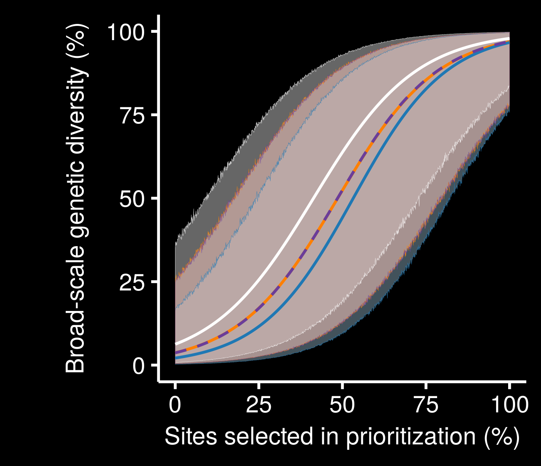
7 amphibian + 3 reptile species
Surrogates for neutral genetic variation may not perform much better than random
Little performance improvement with low budgets
Iberian Peninsula =
HARD MODE
genetic
geographic
random
resistance
Hanson et al. 2021 Cons Biol

Slide 57
Many surrogates are often available,
how do our choices
affect results?

Slide 58
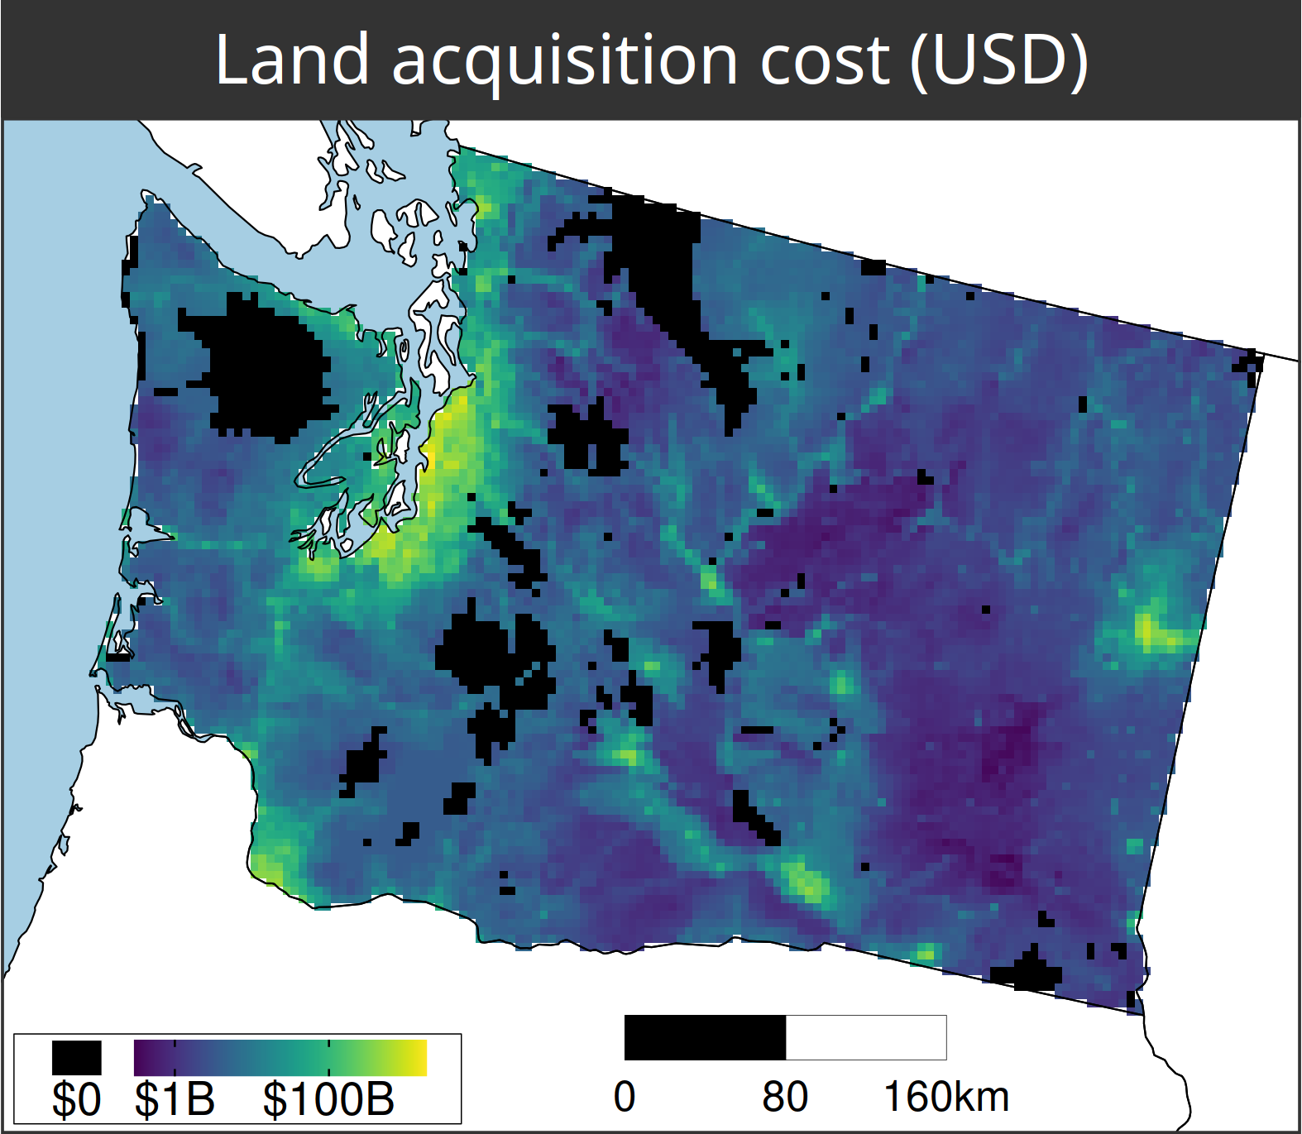
A comparison of approaches for including connectivity in systematic conservation planning
Washington State, USA
261 bird species
Land acquisition costs
Existing protected areas
Multiple land-uses
Multiple eco-systems
Hanson et al. (in press) J Appl Ecol

Slide 59
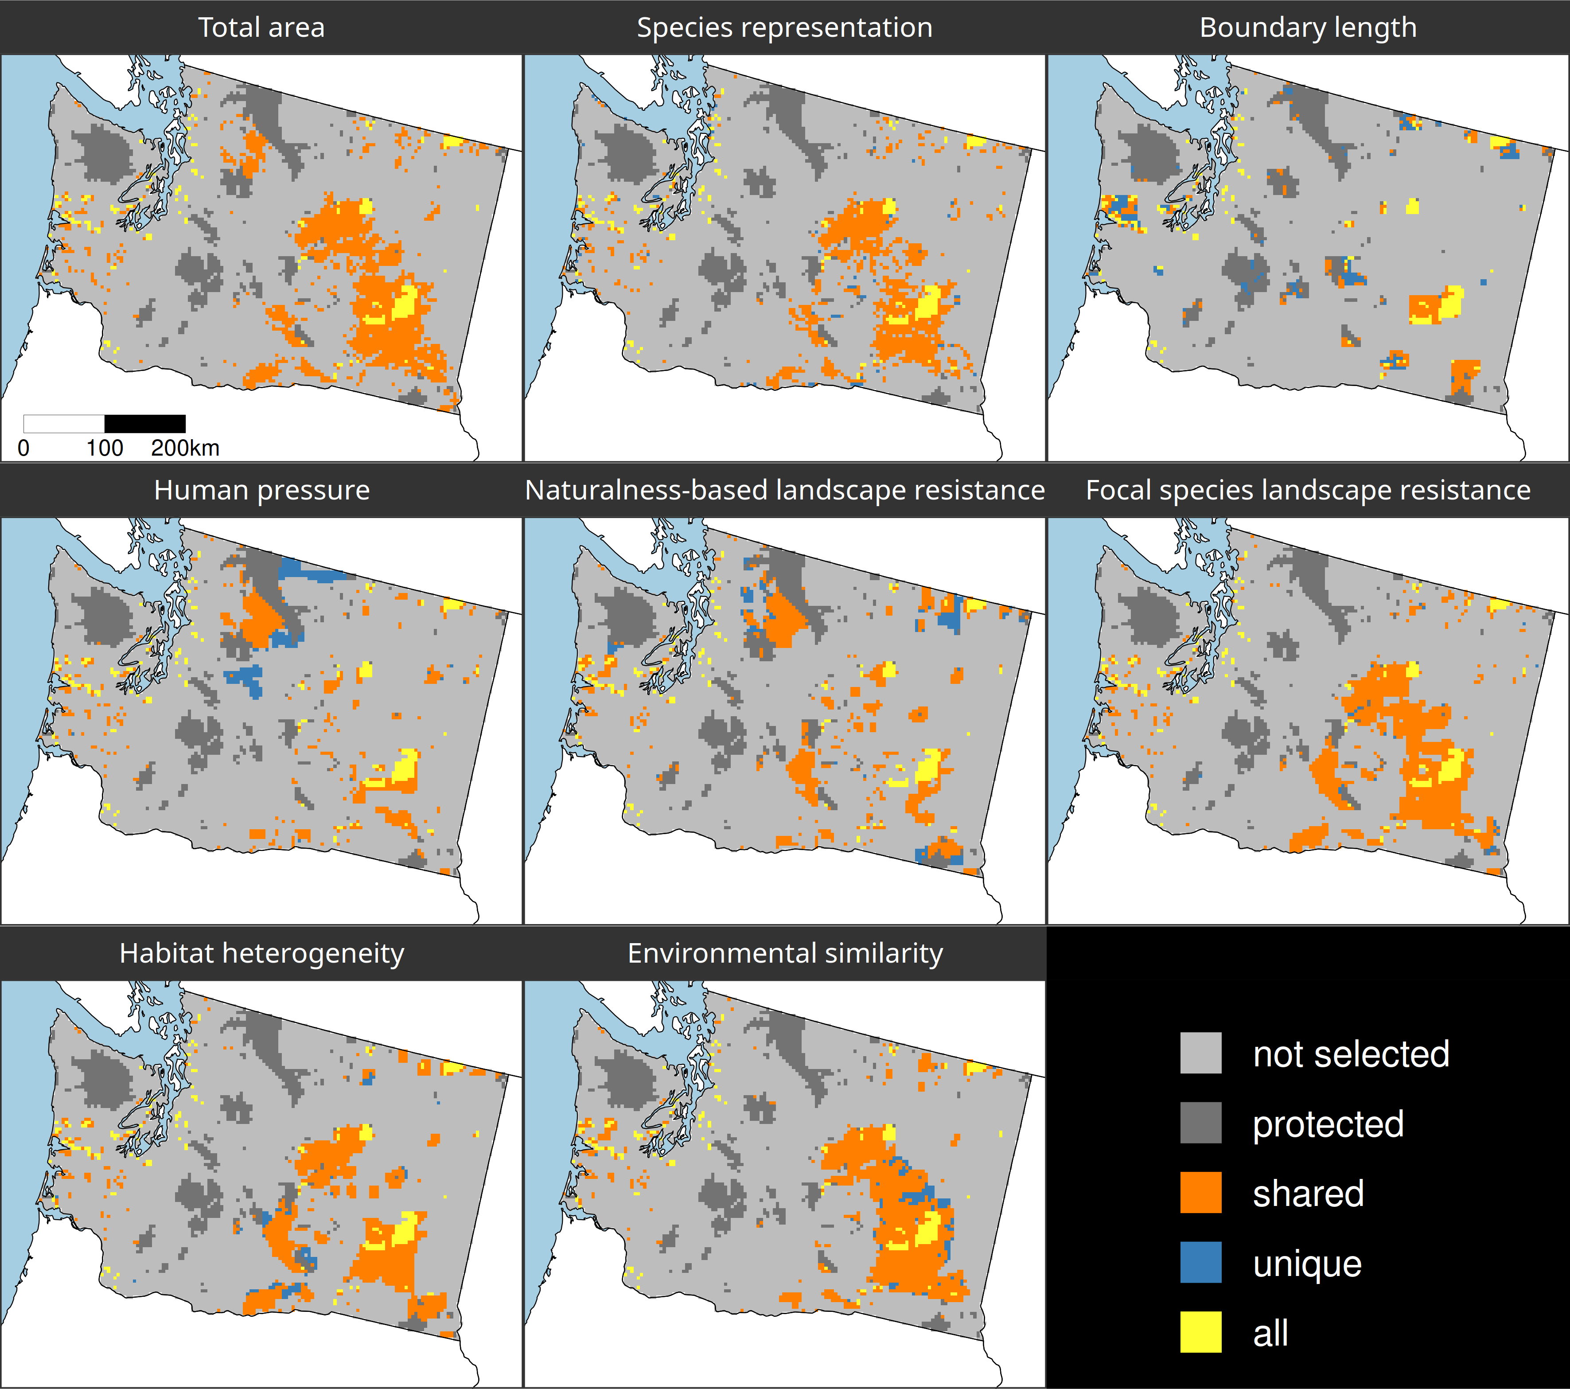
Different connectivity approaches produce different prioritizations
Different connectivity approaches can yield similar prioritizations
Hanson et al. (in press) J Appl Ecol

Slide 60
Make better conservation decisions by using…
1. Better algorithms
2. Cost-effective data
3. Reliable surrogates

Slide 61




jeffrey.hanson@uqconnect.edu.au
github.com/jeffreyhanson
jeffrey-hanson.com

